Slide 1
Paisley’s Bid for UK City of Culture 2021
SURF awards shared learning workshop, Paisley Town Hall

Slide 2
“Cultural programmes are the rocket fuel of regeneration”
David Henshaw, Liverpool 08

Slide 3
UK City of Culture is more than just a title. It’s a focus, a rallying cry, a call to action, an opportunity to create and innovate, to build local pride, to show the world who you are and what you can do.
It can inspire, instil a sense of ambition and provide the base for a real step change.
DCMS guidance

Slide 4
Competition process and timetable
Register by 28 February 2017 ✓
Initial bid by 28 April 2017 ✓
Short list announcement by early July 2017
Final bid submitted by end September 2017
Clarifications and Panel visit October 2017
Announcement of UK City of Culture 2021 December 2017

Slide 5
Why Paisley?
“Paisley has the potential to drive its economic regeneration to establish itself as an international destination for Scottish culture and contemporary performing arts ... rebuild its high street economy using its rich legacy ... for the ultimate benefit of the community of Paisley and Renfrewshire.”
Paisley – The Untold Story

Slide 6
Paisley – Our Pitch
People’s bid – extensive engagement, co-production and co- creation, stories of Paisley’s people
Town of contrasts and potential – historic heritage assets/ and connectivity
Need – Paisley has struggled as a result of economic decline over last decades/ town centre/ poverty
Towns matter – providing a blue print for regeneration for towns across the UK
Reconnect Paisley with our Pattern
Culture – at heart of regeneration strategy

Slide 7
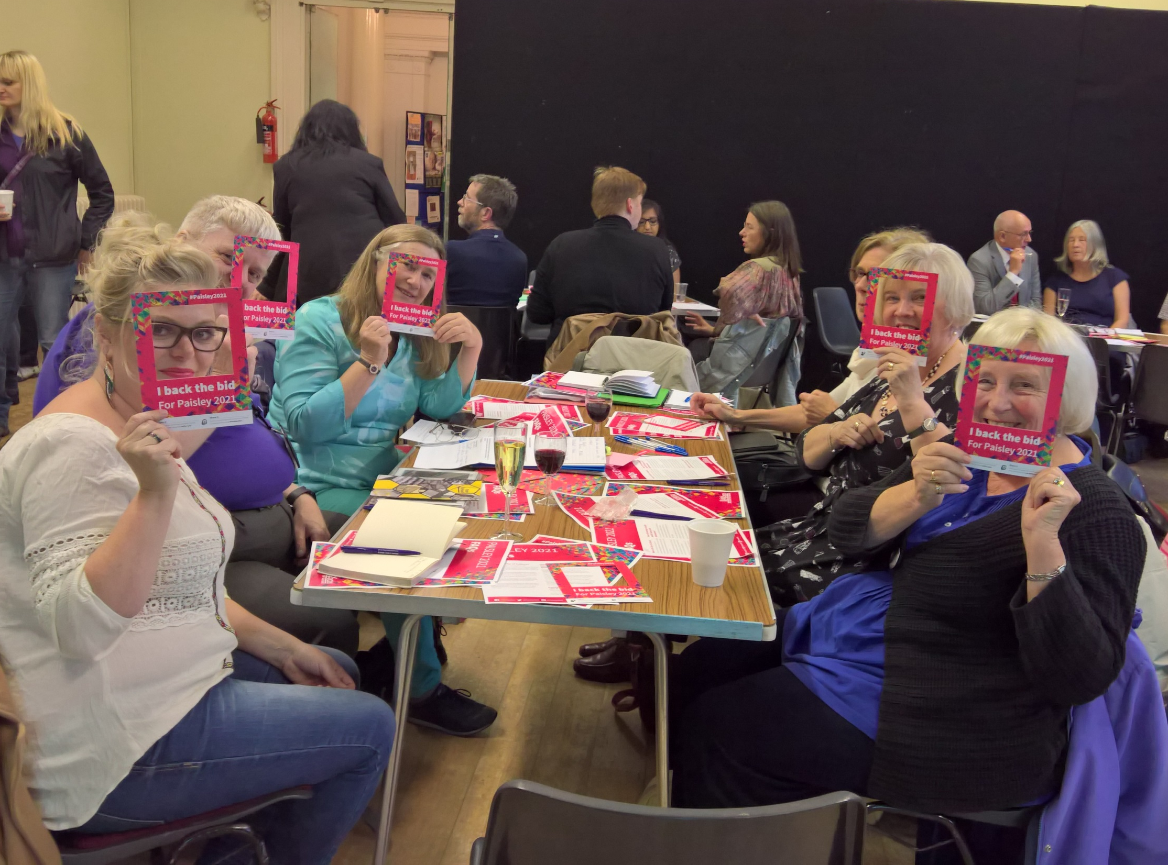
Paisley 2021
Engagement & Participation

Slide 8
 OVERALL Reach >30,000 individuals 
Youth | Music | Visual Arts | History & Heritage | Film | Literature & Spoken Word | Theatre & Dance | Fashion & Applied Arts &
Community Planning & Creative Renfrewshire partnership events
Conference events
Localised community events
Focus groups
Tenants meetings
Culture bus tours
Participatory activities
1,000 responses to the ‘What’s Our Story’ campaign
100s more to Paisley Daily Express ‘Why I Love Paisley’ campaign

Slide 9
paisley2021.com
facebook.com/paisley2021
twitter.com/paisley2021
instagram.com/paisley2021

Slide 10
How to use it

Slide 11
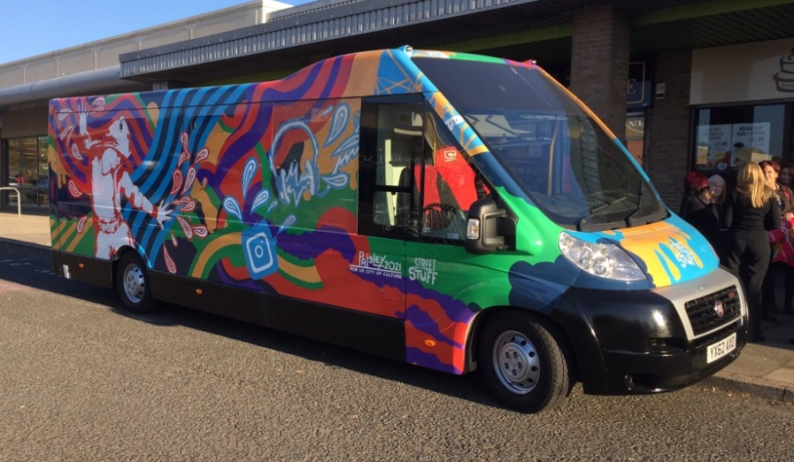
Culture Bus Tours
The thinking behind the plan:
Delivering Paisley 2021 branding packs
Launching our Ambassador Organisations
Reaching and celebrating in our communities
Unleashing the power of social media
Generating energy, buzz and fun
Over 500 people engaged

Slide 12
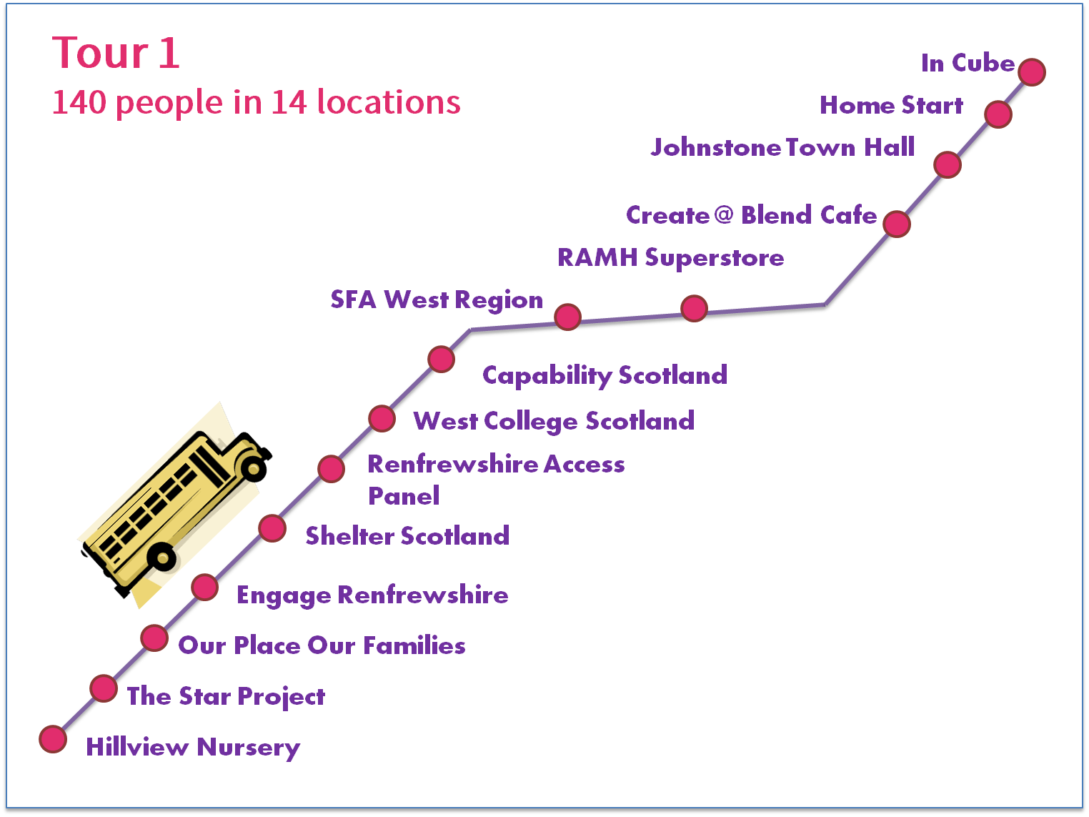
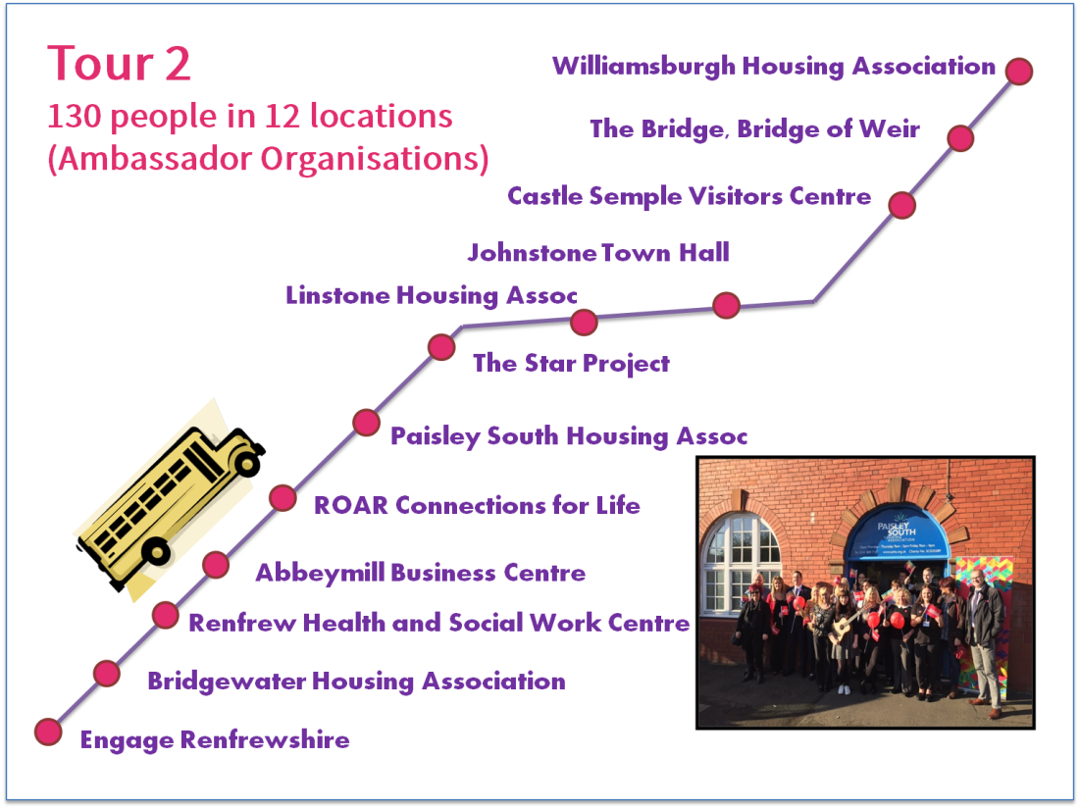
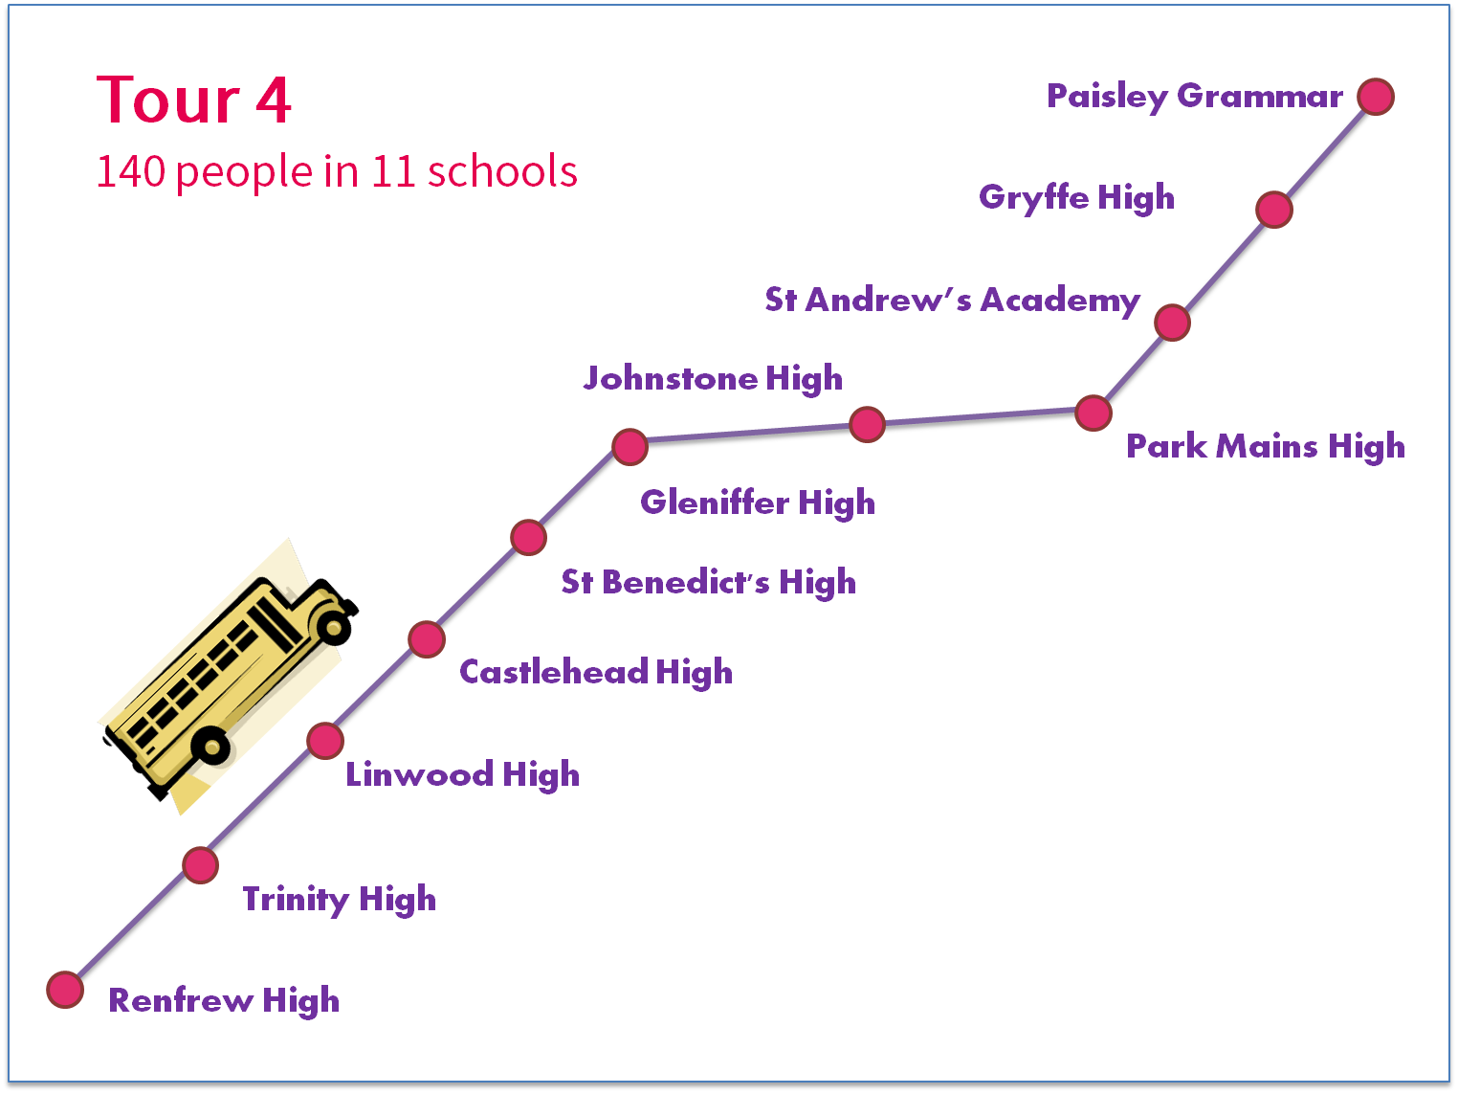

Slide 13
Schools / Youth Voice
Who Cares? Scotland
Twitter Takeover
Grace’s Big Adventure

Slide 14
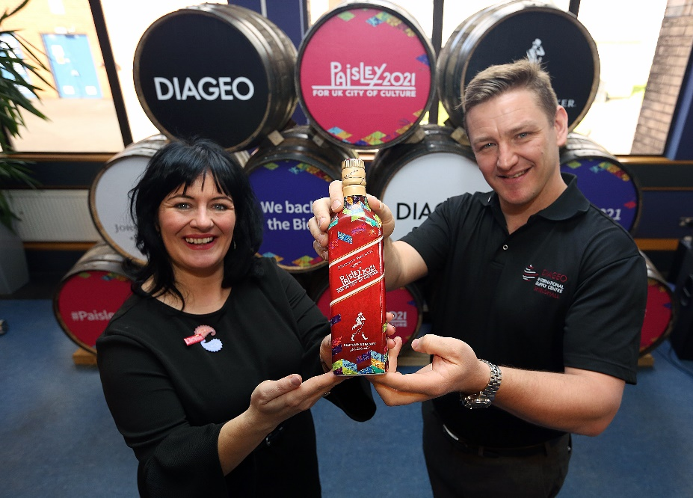
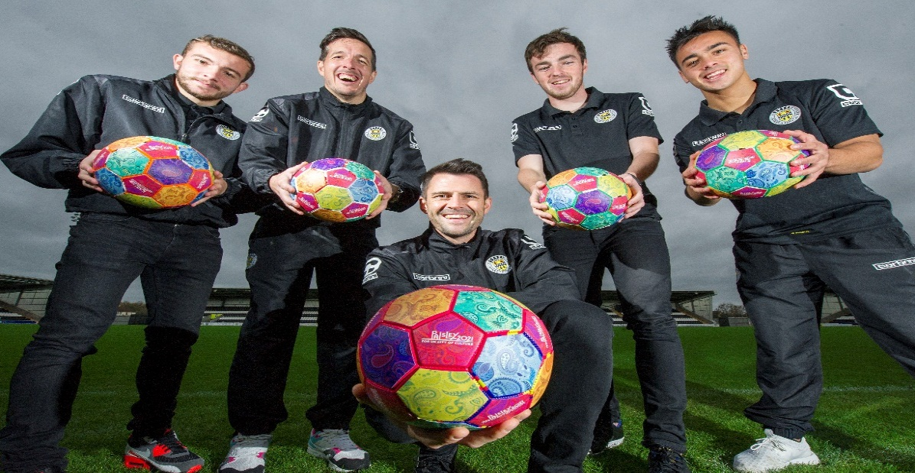
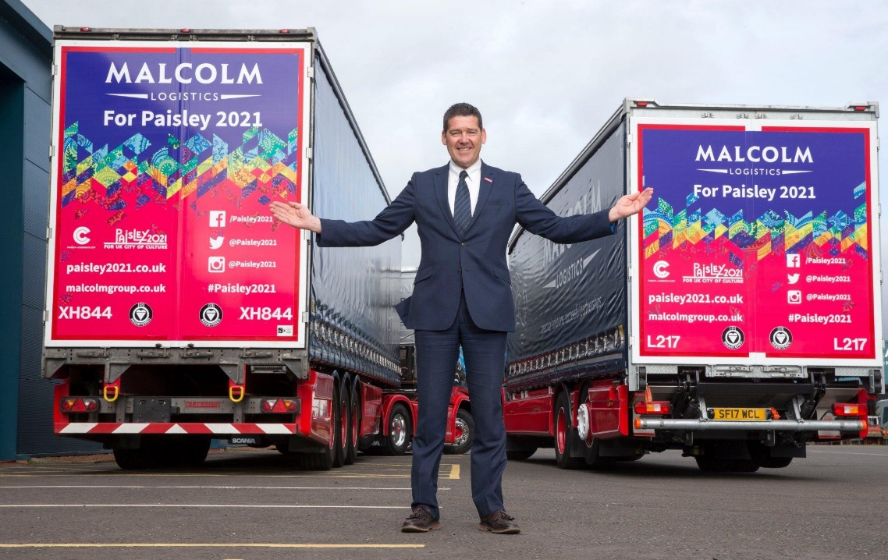
Business @Paisley2021

Slide 15
Culture, Events and Heritage Fund
a significant building block in Paisley’s bid
sets out to raise cultural ambition, enhance participation
unlocks creative potential in Renfrewshire
support our case as to why Paisley needs to be UK City of Culture 2021

Slide 16
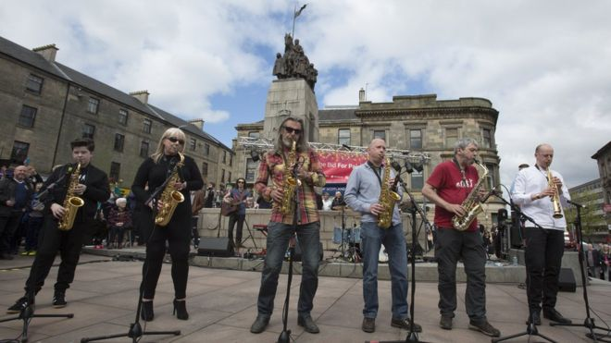
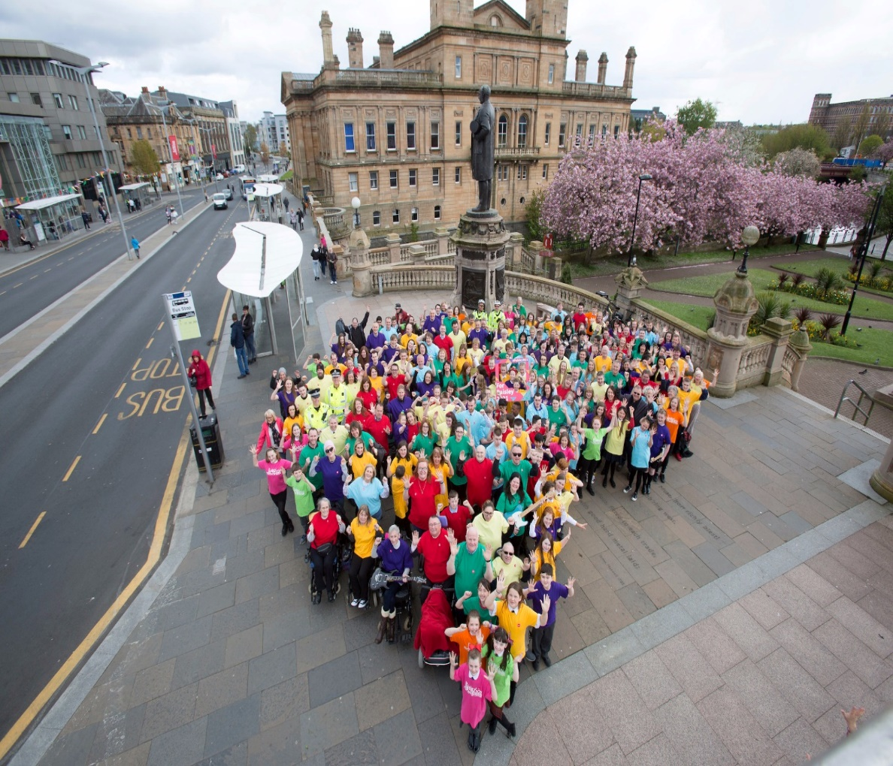
Paisley 2021
Bid Send Off….
“Paisley’s bid for UK City of Culture in 2021… something that we can aim for while representing all that is offered in Paisley … something that is for everyone and that everyone can be proud of, because it includes them.”
Kieran McWhirter, former looked after child, Paisley

Slide 17
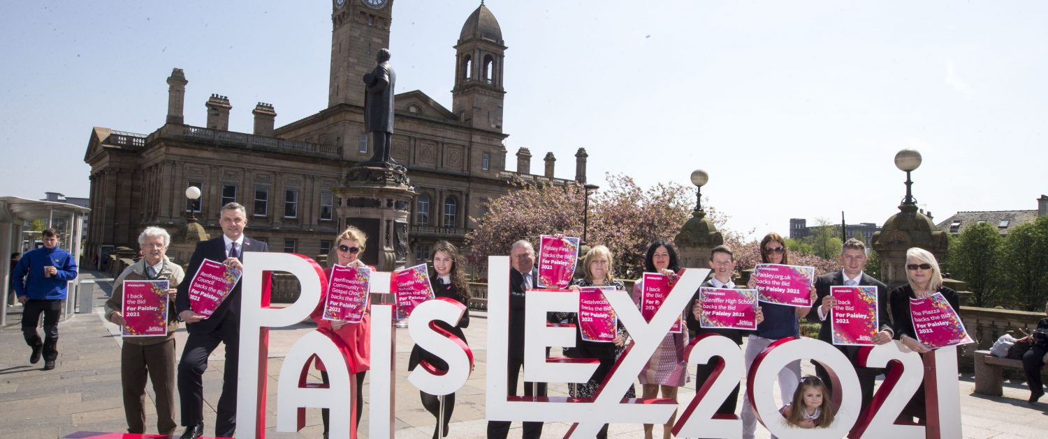
A live learning environment

Slide 18
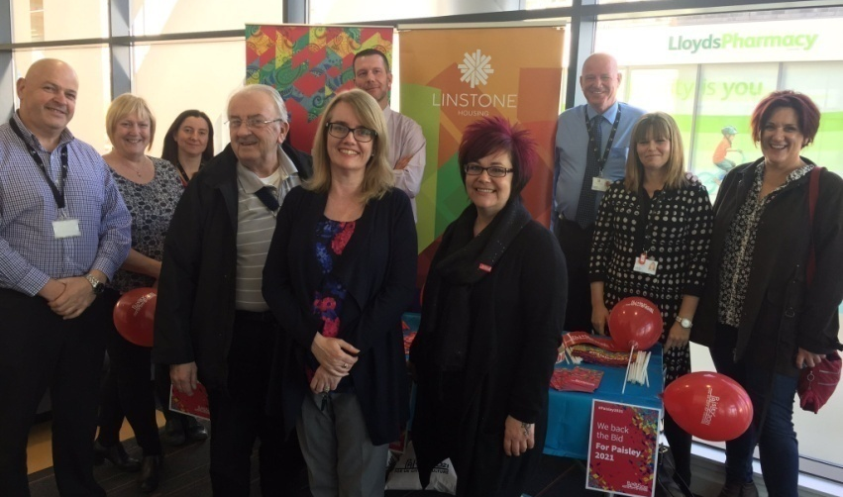
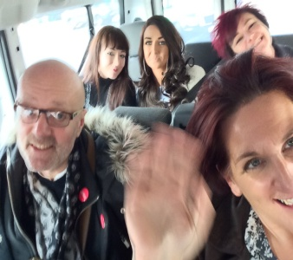
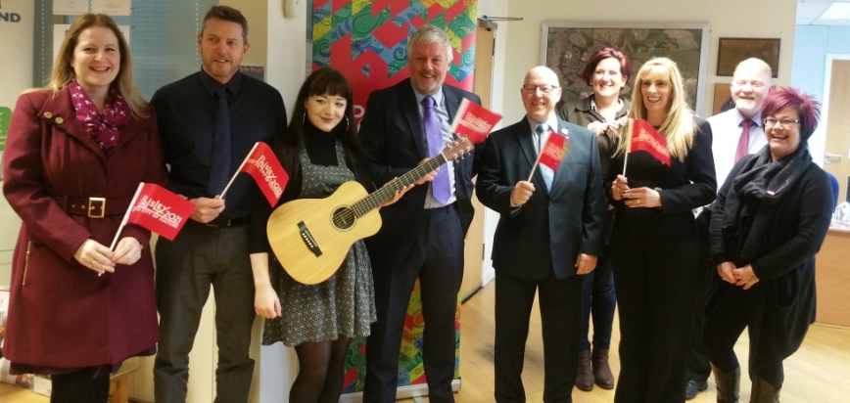
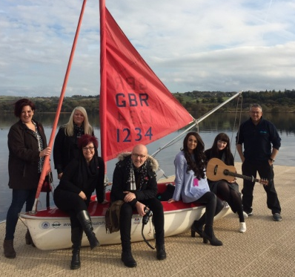
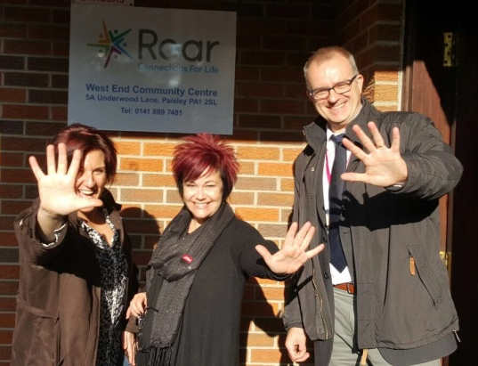
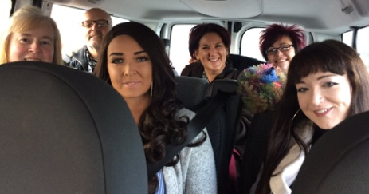
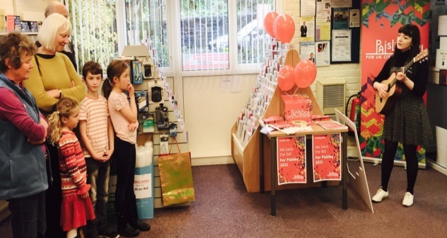
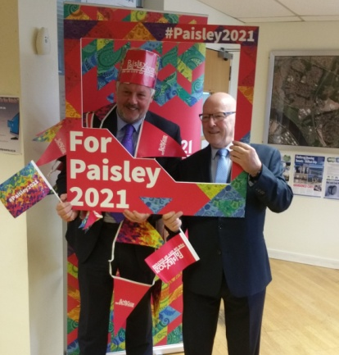
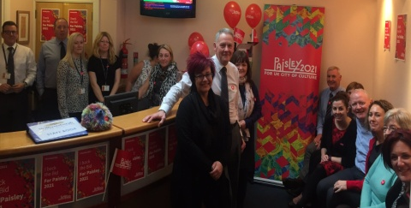
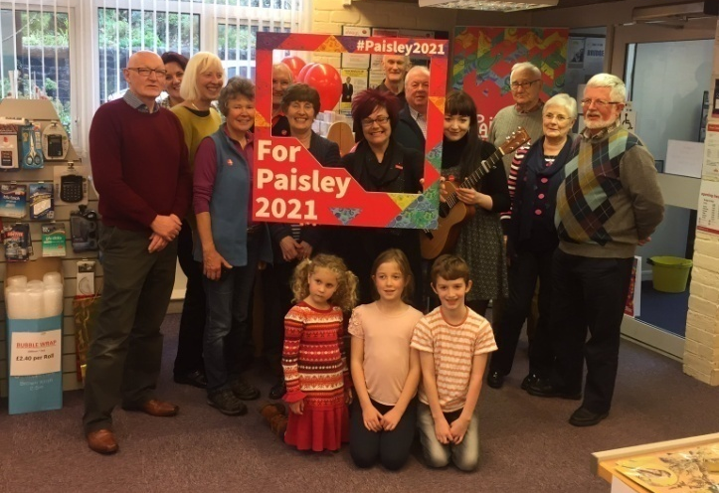
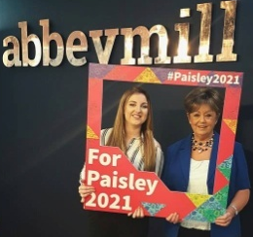
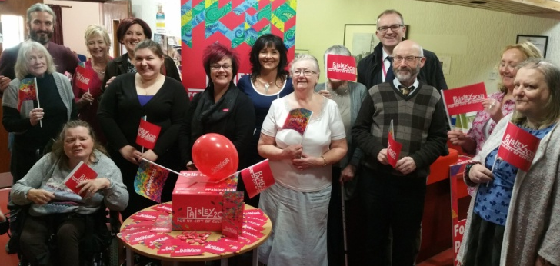
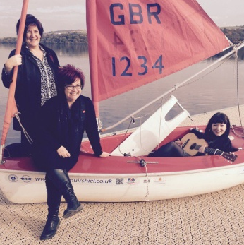
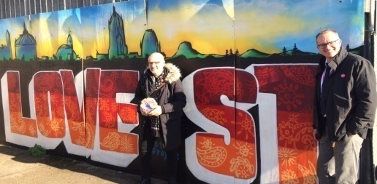
Thank you for listening!
See more at : http://www.paisley2021.co.uk/
Check out: 'The story so far'

