Slide 1
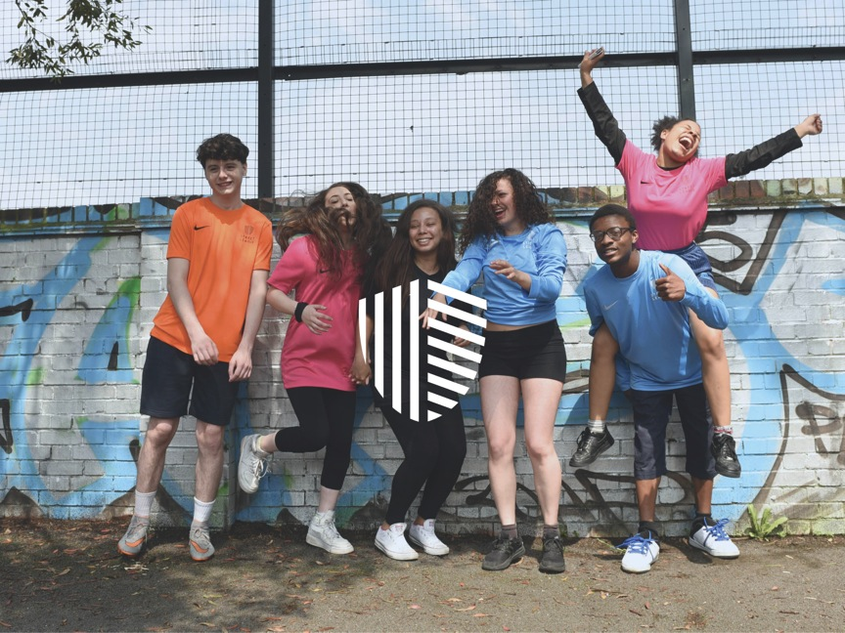
Street League
Shared Learning Presentation
SURF – Removing Barriers: Youth Employability

Slide 2
Introduction to Street League

Slide 3
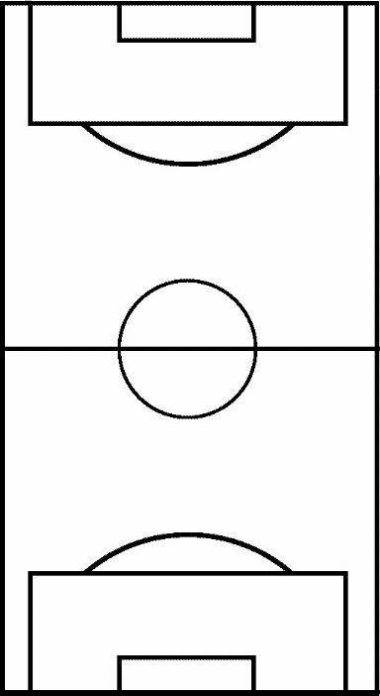
Removing Barriers - Staff
PARTNERSHIPS
AFTERCARE
STAFF AWARDS
QUALS
KIT & TECH
COMMS
QUALITY & PERFORMANCE
OUR PEOPLE
AUTONOMY
MARKETING
CULTURE

Slide 4
Removing Barriers – Young People
CULTURE
PREPARING FOR WORK
PARTNERSHIPS
UPSKILL
STRUCTURE
ACHIEVEMENT
HEALTH & WELLBEING
AFTERCARE

Slide 5
Case Study

Slide 6
Thank you for listening
#MovingintoWork
@Street_League
www.streetleague.co.uk

