Slide 1
SURF Awards
Shared Learning Workshop
Alison Strauss
Arts Development Officer (Film and Media) /
Director Hippodrome Festival of Silent Cinema
alison.strauss@falkirkcommunitytrust.org
Notes:
Thank you very much indeed for inviting me to be part of today’s sessions. My name is Alison Strauss and I’m delighted to be here to tell you a bit about the Hippodrome Silent Film Festival (or HippFest), some of the challenges we’ve faced, how we’ve overcome them… and some of the things we’re still wrestling with.

Slide 2
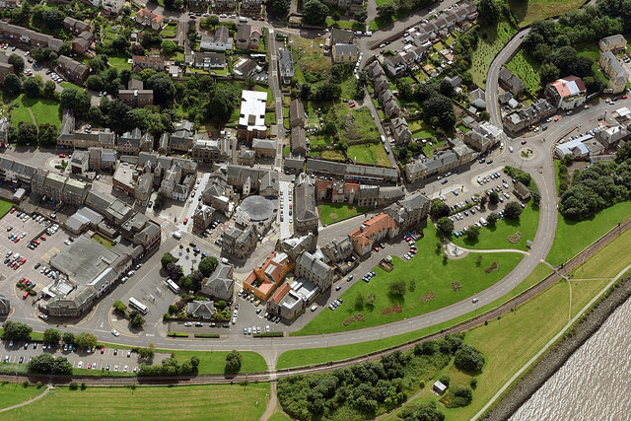
• Former heavy industry and mining town • Top 15% SDI • No train links • Derelict buildings , foreshore & harbour • Stalled development work •
Notes:
Bo’ness a smallish town on the Firth of Forth,
Around half-way between Edinburgh and Glasgow.
Was a centre for heavy industry, coal-mining and one of Scotland's largest shipping ports.
Now, the local population in Bo’ness are amongst the 15% most deprived in indexes of social deprivation.
Many key buildings within the town, as well as the harbour and foreshore area of Bo'ness have lain derelict for over 30 years.
There were some development proposals on the table but with the economic downturn and other engineering factors, these were stalled.
In response the Bo'ness Townscape Heritage Initiative, with close community collaboration and support, secured Heritage Lottery Funding and Historic Environment Scotland (Conservation Area Regeneration Scheme) funding.
The idea was to address the decline of the traditional town centre by a number of measures, critical amongst these being the restoration and operation of Scotland’s first purpose built cinema, the category A listed Hippodrome.

Slide 3
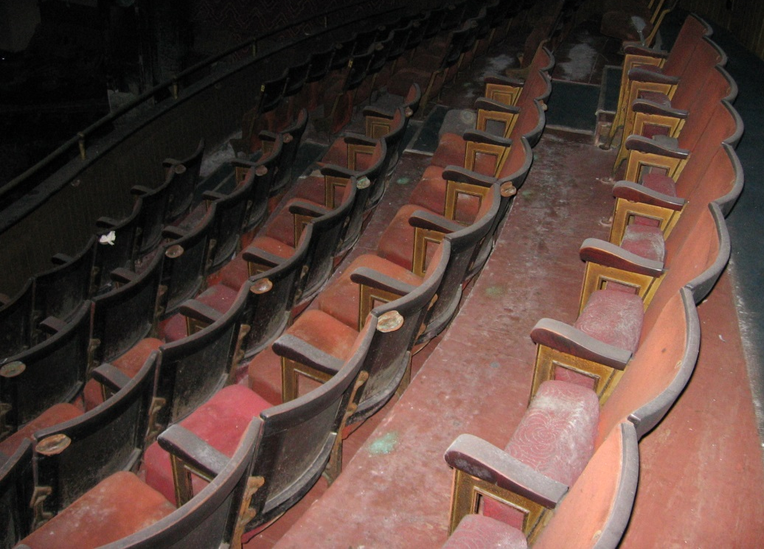
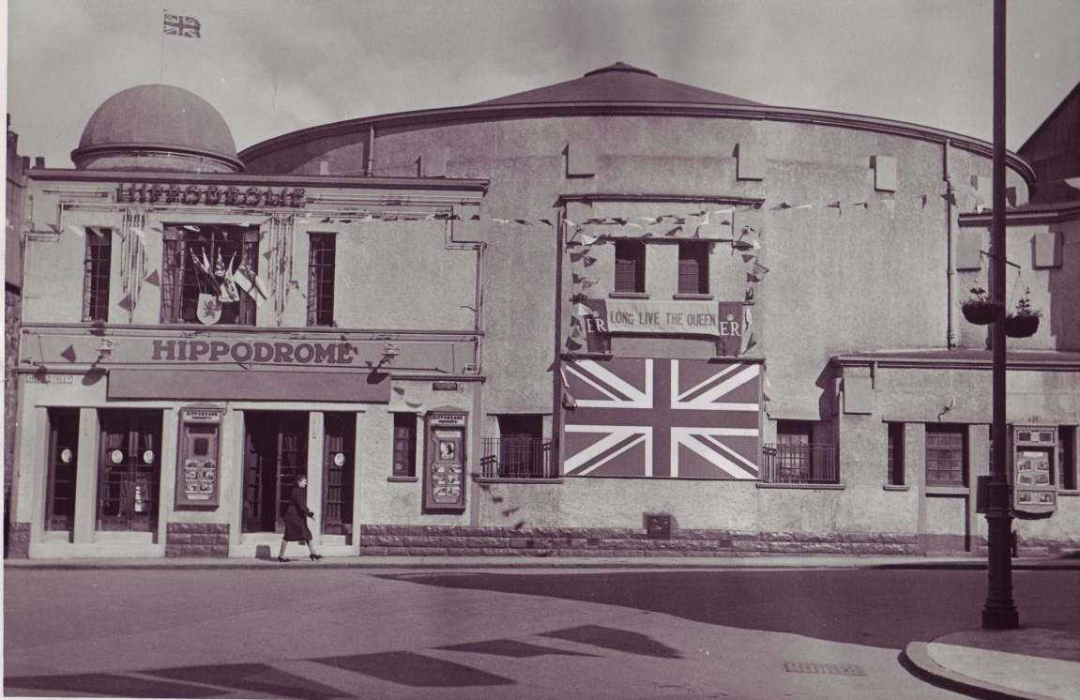
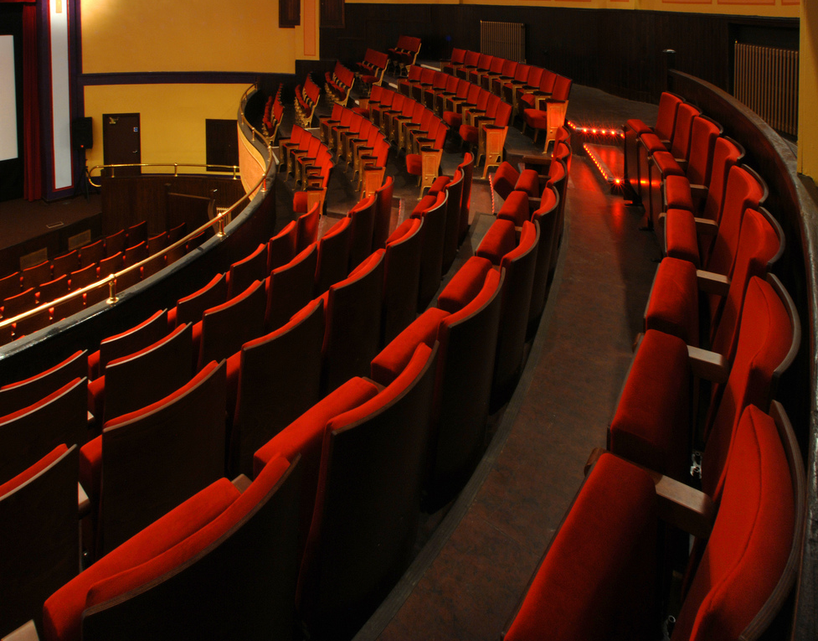
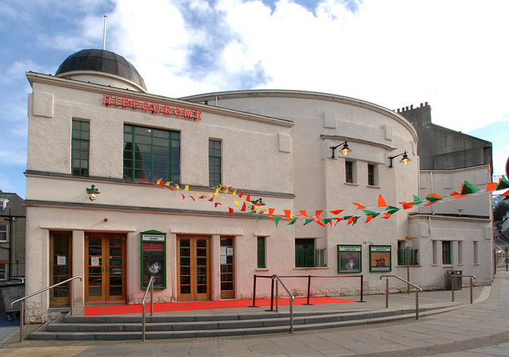
Notes:
The Hippodrome first opened 1912 and had operated as a cinema until 1975, then became a bingo hall, then fell into disrepair. After the restoration the management was taken on by Falkirk Council and it re-opened as a cinema in April 2009. Now run by Falkirk Community Trust.
Research and stakeholder consultation (2010) encouraged us to initiate an annual festival as a key to spearheading regeneration in the area.
In 2011 we launched the Hippodrome Silent Film Festival (HippFest) linking the heritage of the building with the heritage of the film medium itself.
We have held seven festivals annually in March so far.

Slide 4
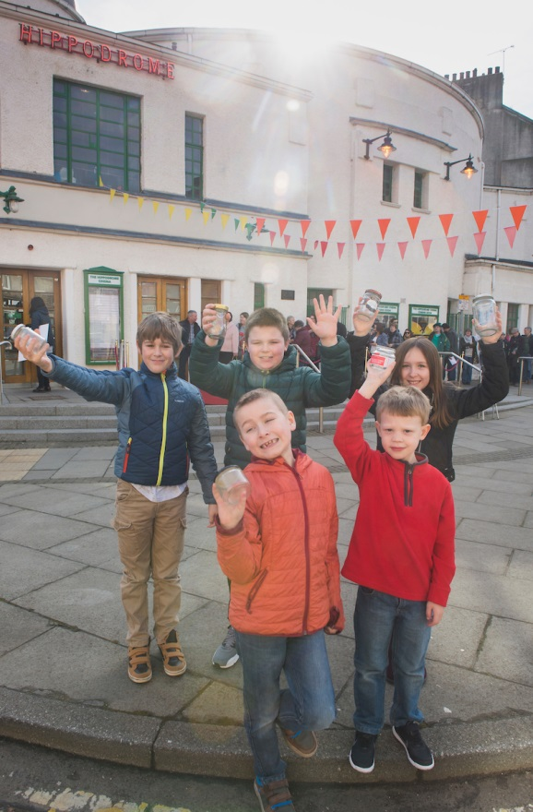
Festival Long-Term Vision
‘To be Scotland’s principal commissioning silent film and live music festival – centred in Scotland’s first and oldest cinema, engaged with the local Bo’ness community, and drawing audiences from across Scotland, the UK and beyond.’
Ethos
• An inclusive and non-hierarchical approach to silent film
• Exceptional, out-of-the ordinary cinema experiences
• Accessibility and diversity in all elements of delivery
• The highest standards of presentation
• A programme which fosters discovery and challenge
• Productive partnerships between community, artists and audiences
Notes:
This is our vision for HippFest.
The principles underlying our notion of what the Festival could and should be were in place early on. These values (up on the slide) inform all our activities.

Slide 5
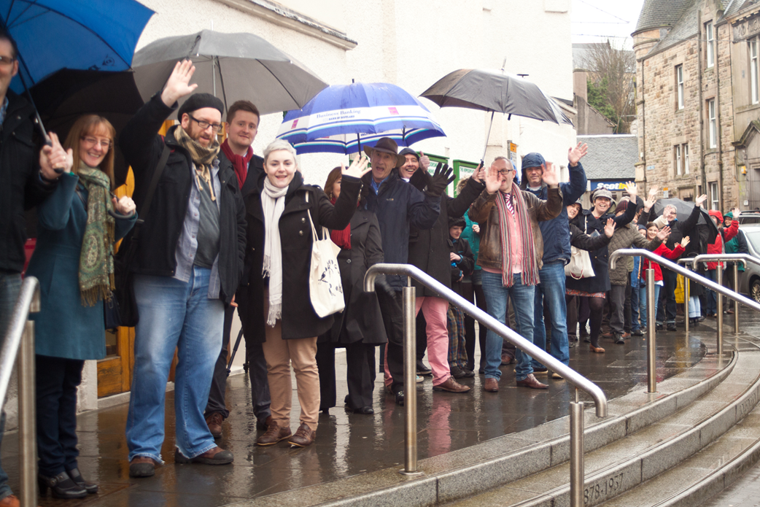
Notes:
Since HippFest was established we have welcomed over 11,000 people to Bo’ness to experience unique cinema experiences and to do so we have joined forces with community organisations and venues, visitor attractions, schools and businesses in the area. These strong roots in the town have been key to HippFest’s success and have meant that, rather than just being parachuted in once a year, the Festival is part of the town and part of the pride that people have for Bo’ness.
I’d now like to show you a short film about HippFest to give you a wee flavour of people’s response to it.
[Screen 2 minute film] https://vimeo.com/177529197
password - HIPP16

Slide 6
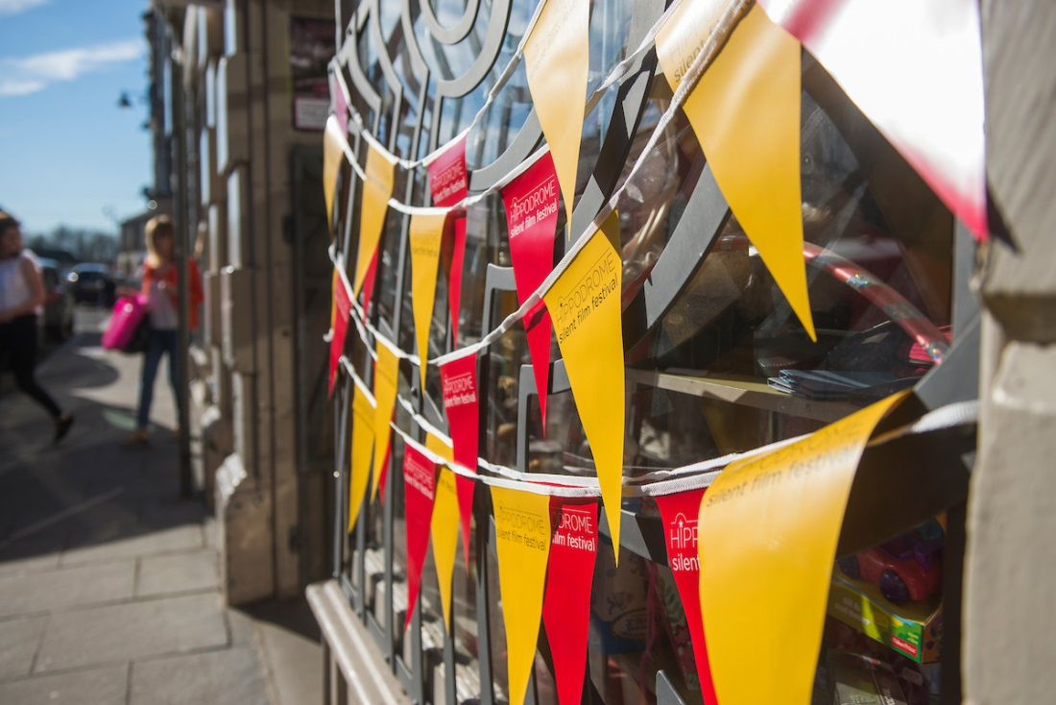
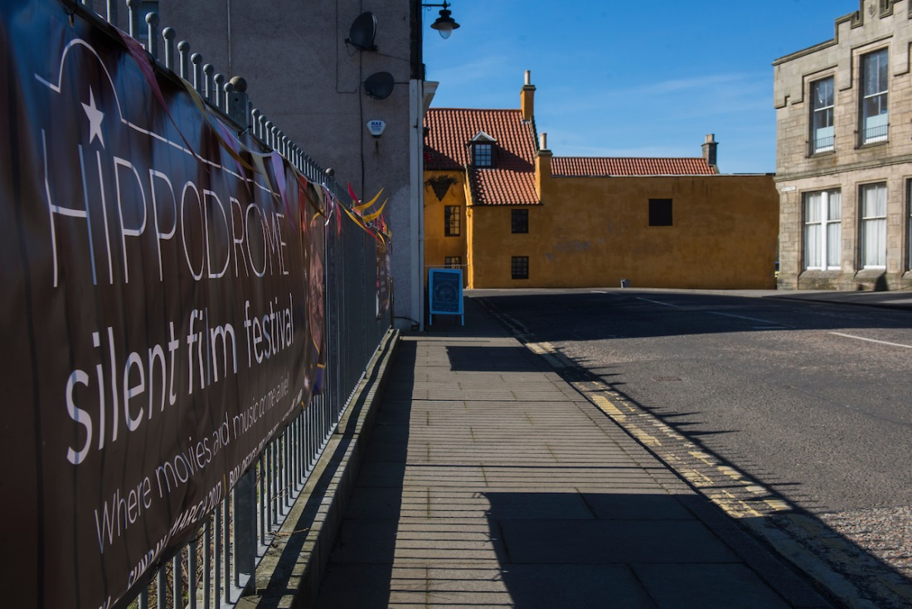
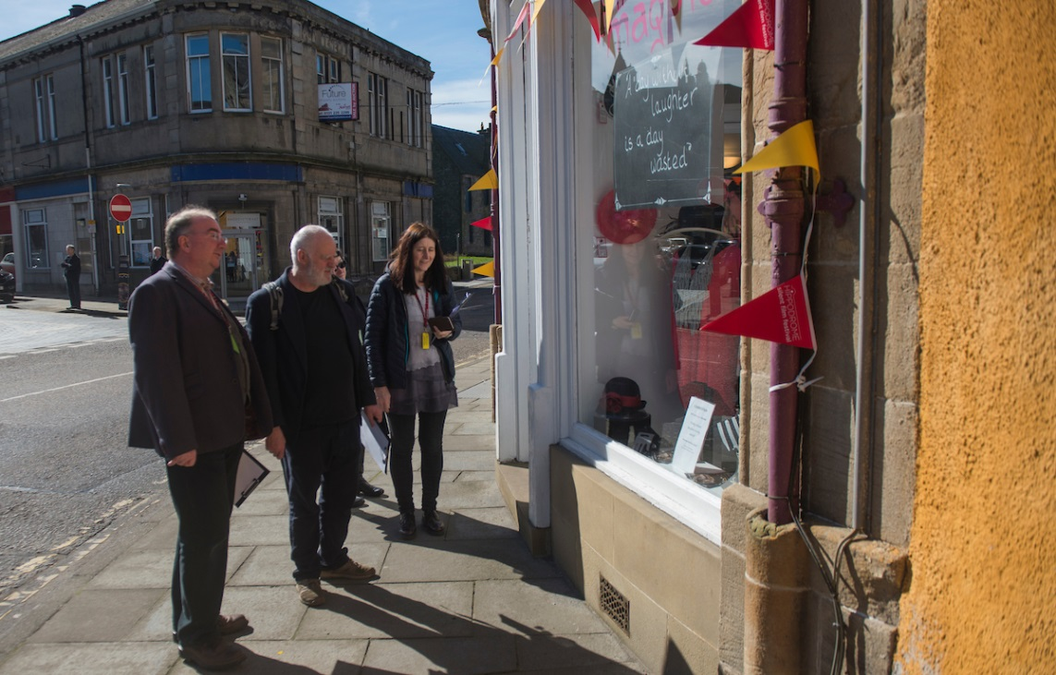
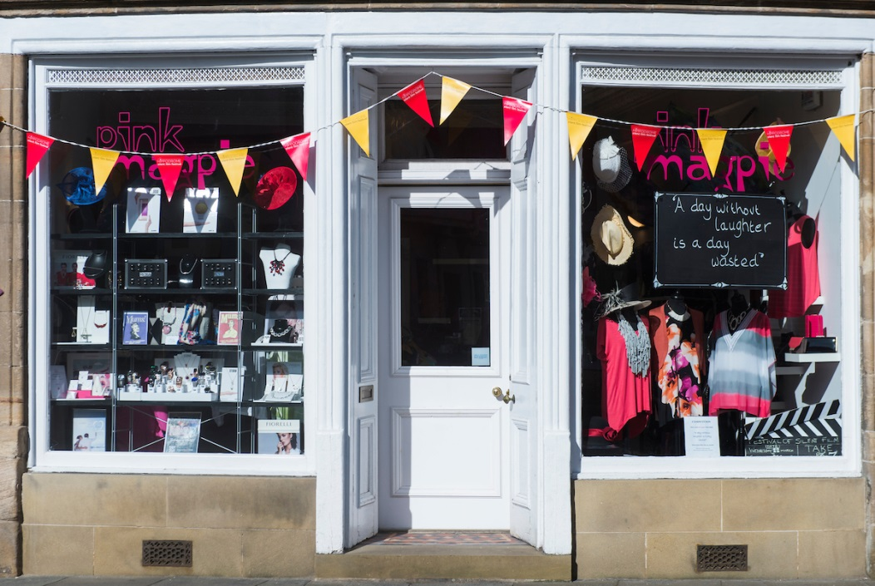
Encouraging footfall across the town…
• Window dressing competition • Hosting pop-ups
• HippFest brochure directory • Regular communication • Dressing the town
Notes:
There is a major visitor attraction in Bo’ness – the Bo’ness and Kinneil heritage railway and museum. 70,000 visitors in 2016 – sign saying “turn left for town centre shopping” but that’s it. Resentment.
Our challenge was how to encourage footfall across the town, drawing people into Bo’ness – not just to come to the Hippodrome and go away again, but to shop and eat in the town, to stay the night and properly explore what the area has to offer. Good for us too as all helps create a truly buzzing atmosphere.
98% of HippFest survey respondents have told us that the Festival is their reason for visiting Bo’ness and we want to support the town to capitalise on that.
The window dressing competition encourages a collaborative feel and ‘dresses’ the town to enhance the festival atmosphere.
All the businesses are listed in our printed brochure (9,000 circulation) (pages dedicated to ‘Love Bo’ness For Eating and Drinking’, ‘Love Bo’ness for shopping’) and maps are given to audiences
The team stays in regular contact with the businesses through face-to-face visits, mutual/reciprocal use of social media and attendance at Buzzness the town’s business networking group. They discuss all sorts and its not always relevant to us but maintaining the link is really important.
Took over a vacant shop as a Festival hub, in the heart of the town
Some shops don’t have ‘fronts’ or haven’t joined in the dressing so to make things easier we provided shops and cafes themed bunting.

Slide 7
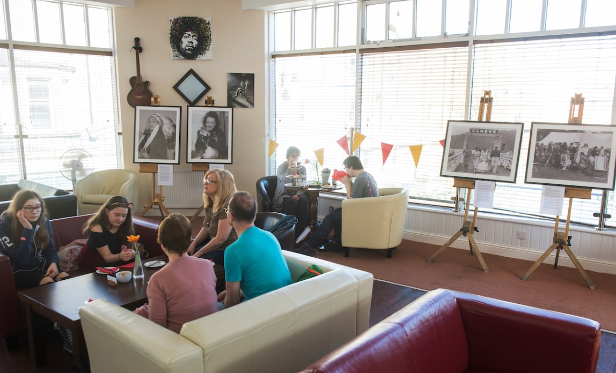
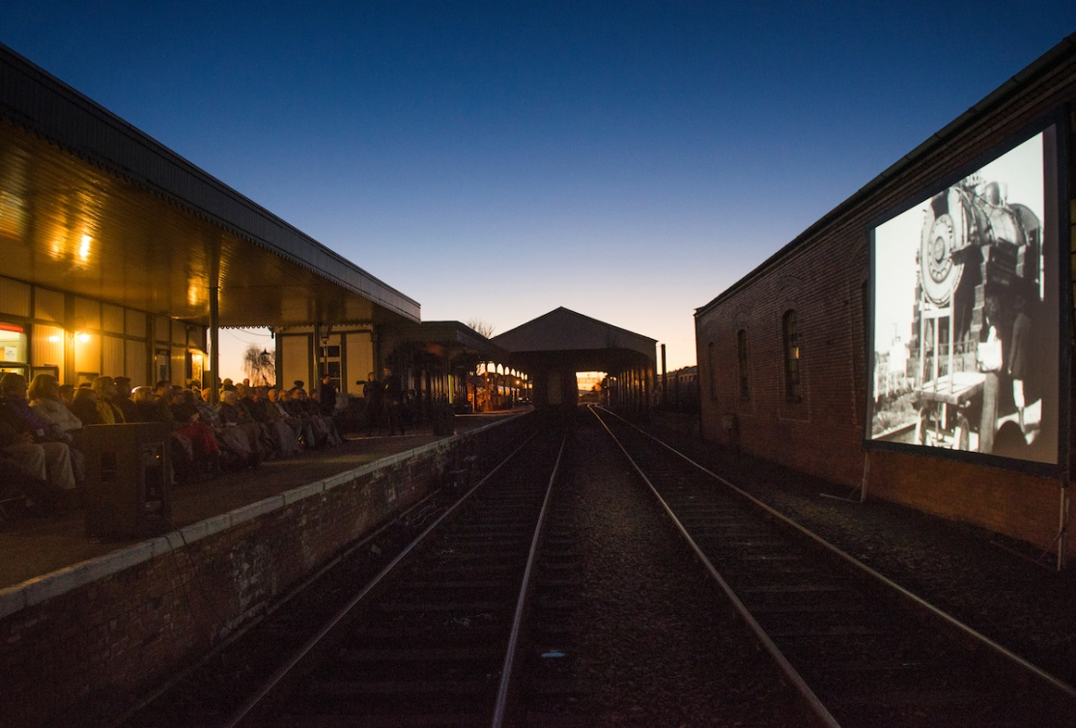
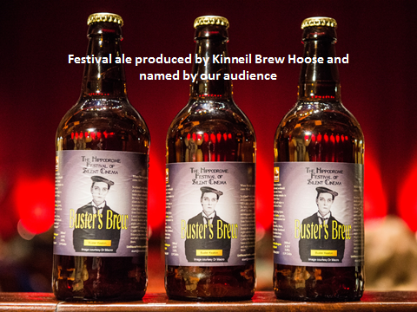
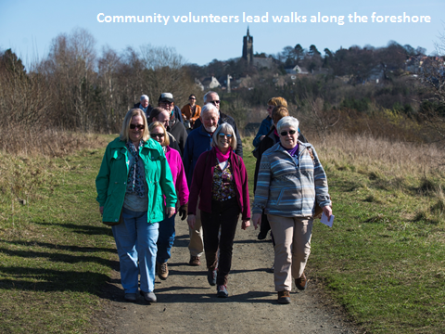
The Horn’s Bakery Café hosted the ‘Silent Stars in Scotland’ photography Exhibition
The Bo’ness and Kinneil Heritage Railway hosted a pop-up screening on the platform
Extending capacity & engagement though venue partnerships
Notes:
One of the challenges for HippFest is our limited capacity .
Adding new venues allows us to extend our offering as well as encouraging more exploration of the area (boosting tourism) and now 22% of those surveyed combined their visit with visits to other attractions in the area.
Here are some of the venues we’ve added to the Festival, and we’ve also embraced the library, the Barony Theatre, the Town Hall, and Kinneil House.
You know you’re making an impact when local venues start delivering their own projects independently, and then the new challenge becomes remaining relevant as the need in the area evolves. The Corbie Inn were keen to expand by opening a function room and we worked together to use this newly opened space in the town as a ‘pop up’ venue for the headline Saturday night ‘Speakeasy’ event for HippFest 16. Now they have gained in confidence and are trialling dementia friendly screenings in their function room.

Slide 8
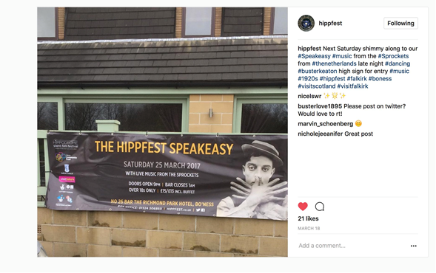
Overnight stays
Notes:
We want to encourage overnight stays so there is more spend in the town and so that audiences commit to attendance at more events.
It is working to some extent as the local hotel and b&b economy is boosted during HippFest with 12% of surveyed audience members staying overnight.
HippFest Speakeasy this year with Buster Keaton in this image demonstrating the secret sign that had to be proffered to the doorman to gain entry.
The on-going challenge is that we have reached capacity with overnight stays and there isn’t the infrastructure to meet our ambitions for increasing visitor numbers from outwith the area. It’d be good to hear from others about any work to encourage air bnb set ups in regeneration areas.

Slide 9
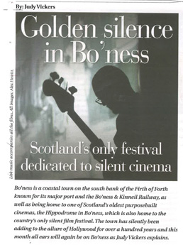
Perceptions
Notes:
Perceptions of the town in some areas, especially Falkirk, are negative.
Husband’s reaction on getting the job was “don’t take the car or you’ll come back and find the wheels gone and it’s balancing on bricks.
Ongoing work to celebrate the attractions of the town including PR
There are on-going negative perceptions and our promotional film for next year needs to focus on the positive image of the town.

Slide 10
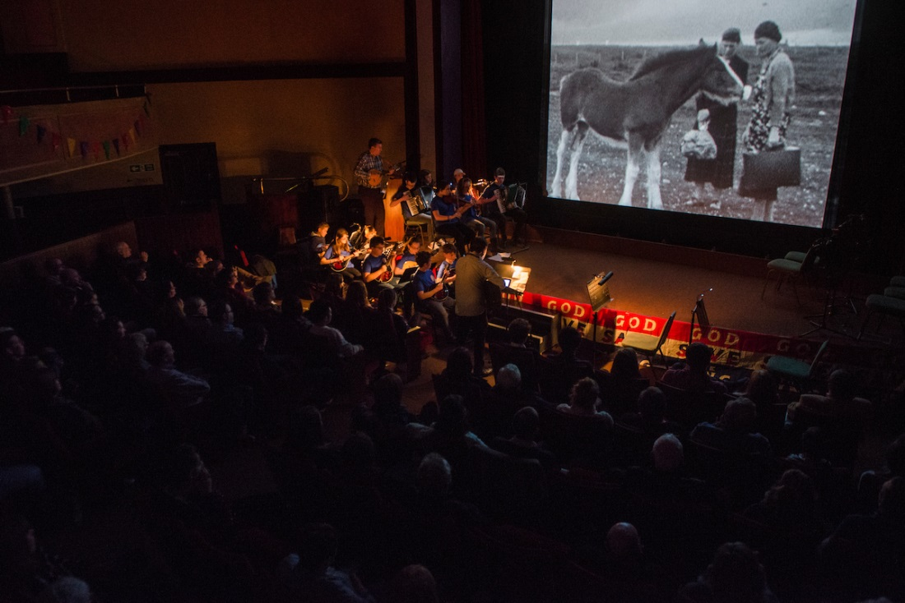
A sense of connection to others in the audience
New insights into other cultures or types of people
Exposed to a new issue, idea or point of view
Feeling less alone or isolated
A more positive mood or outlook
Better able to cope with everyday stresses
Stronger relationships with others
More self-confident about yourself
Proud of who you are & where you come from
Notes:
Despite the negative perceptions from outside, pride in the town is very fierce.
Some of the older generation still call the cinema ‘Dicksons’ - the pioneering local entrepreneur whose brain-child the cinema was back in the silent era’s heyday, and the proprietor for decades.
The very concept of the HippFest celebrates this pioneer’s vision as well as the films we show. We screen the earliest Bo’ness Fair films, made by Mr Dickson himself, which really resonates with local people. We root the programme in the local area.
We also screen films featuring locally-born James Finlayson, (co-star to Laurel and Hardy), and shorts from the National Library of Scotland’s Moving Image Archive documenting the industrial and cultural heritage of the local area and Scotland.
Those statements in the slide are taken from an independent survey last year of attenders who indicated they had “sometimes” or “often” “experienced these things as a result of attending a Hippodrome screening.

Slide 11
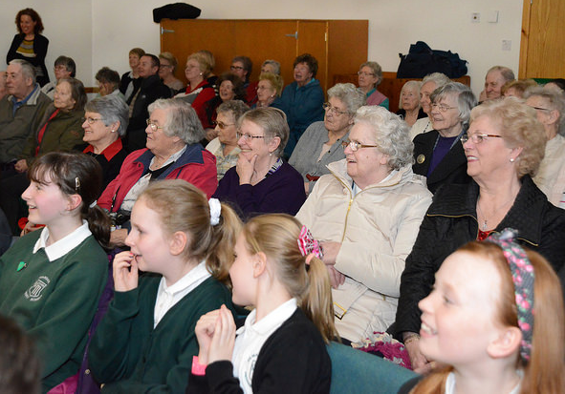
Accessibility and affordability
Notes:
We’re committed to making sure we are accessible for those with low incomes but this is one of our biggest challenges because mounting a silent film festival is very expensive. The box office only accounts for around 10% of the overall income needed.
We have met this challenge by securing business sponsorship to deliver a Community Tour taking silent cinema, live music and other engagement activities to venues across the wider Bo’ness area, with no admission charge.

Slide 12
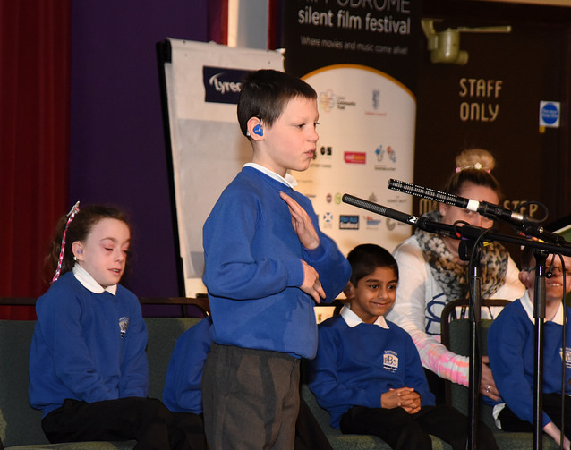
Devising & delivering the programme with partners
Notes:
Another challenge has been ensuring our schools programme is relevant. We learned the hard way and have cancelled a couple of workshops because of insufficient take up.
Our most successful education sector workshops have been when we have worked with primary schools to devise and deliver the workshops rather than programming in third parties.
This image is of Windsor Park primary school pupils led a workshop ‘Silent Sing and Sign’ inspired by the silent era when deaf and hard of hearing people were on a level playing field with hearing audiences.

Slide 13
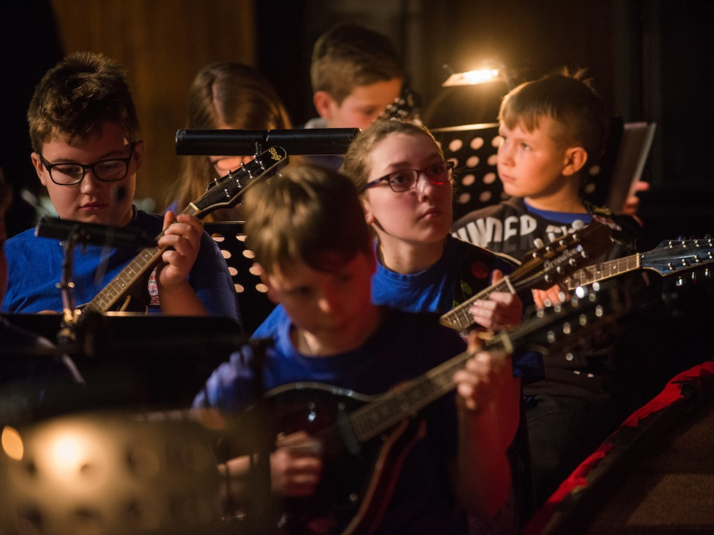
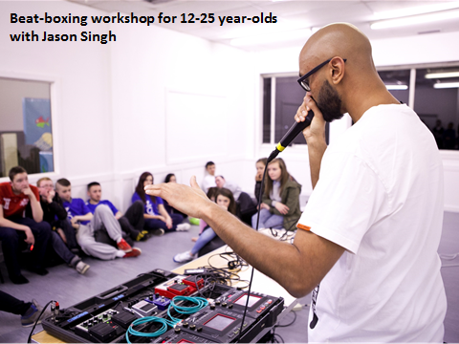
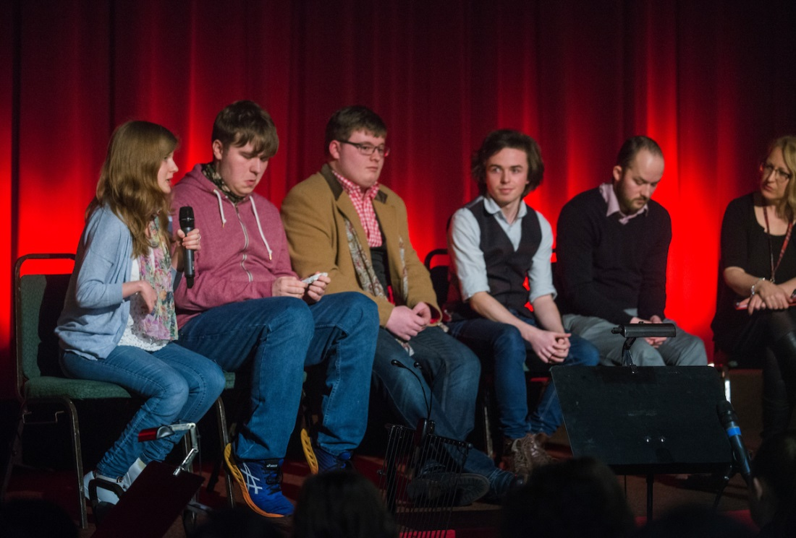
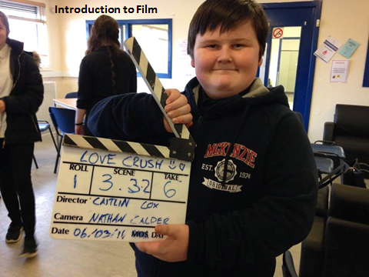
‘New Found Sound’
‘Keeping it Reel’
Notes:
One of the toughest nuts to crack has been connecting with an audience of 12-25-year-olds. These are some of the projects we’ve run targeting this age group. The key common denominator is their active hands-on nature.

Slide 14
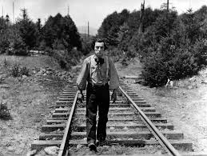
On-going challenges
Aligning local business operations & audience demand
Poor public transport provision
Notes:
Getting cafes and restaurants to meet demand – resistance to adjusting opening hours – chip shop shuts at 7pm on Saturday and stays closed all day Sunday - we want to fill the gap of catering but it goes against what we’re trying to achieve to bring in external providers
Transport – challenge to bring people to town when there is no mainline train station and bus service is limited. Tried taxi with limited success – will attempt again next year

Slide 15
SURF Awards
Shared Learning Workshop
Thank you!
Any questions?
Alison Strauss
Arts Development Officer (Film and Media) /
Director Hippodrome Festival of Silent Cinema
alison.strauss@falkirkcommunitytrust.org
HippFest photos by Alex Hewitt www.alexhewitt.co.uk and Lisa Evans, courtesy of Falkirk Community Trust
Notes:
Thank you very much indeed for listening!

