Slide 1
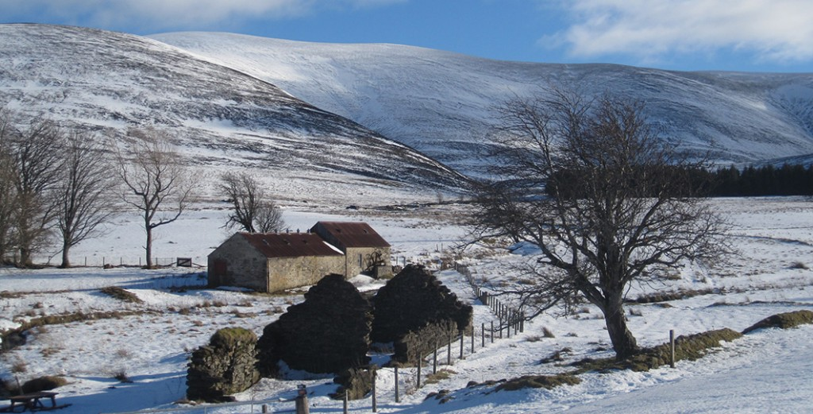
Tomintoul and Glenlivet Regeneration Project
Lee Haxton
Community Support Manager
Cairngorms National Park Authority

Slide 2
Points to Cover
Background to the Project
Regeneration Strategy & Action Plan
Development Trust
Landscape Partnership
The Future
Ongoing Challenges & Lessons

Slide 3
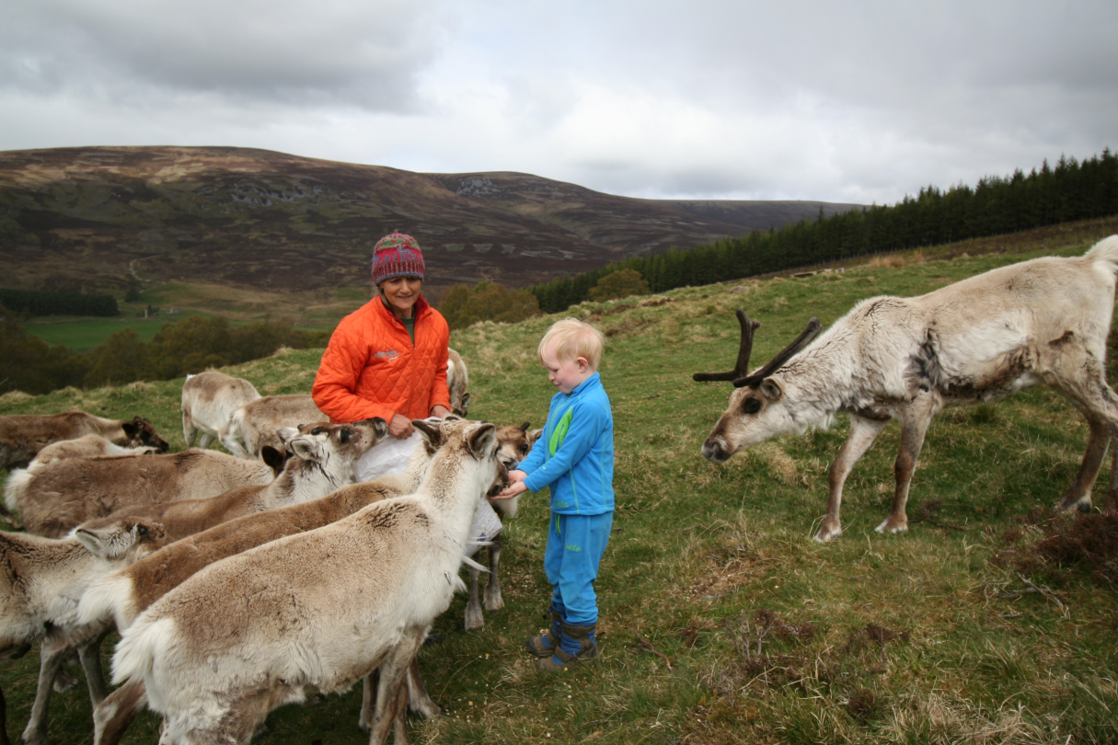
1. Background
Historic challenges
Purpose and role
Topography
Population
Location
Notes:
Historic Challenges
Tomintoul was founded as a planned village by the 4th Duke of Gordon in 1775 – hoping to take advantage of the linen trade
Mechanisation meant that this never happened and residents quickly looked for employment in land based industries
Tomintoul has been the main service centre for the area, historically hosting the primary school (and until 2000 the secondary school), GP surgery, store and post office
Glenlivet has a long history of upland agriculture and rough grazing – it also the centre of the Speyside whisky industry and has a long history and culture of whisky smuggling
The Glenlivet estate was purchased by the Crown Estate in 1937
The area is now heavily reliant on land based industries, whisky and tourism for income
Tomintoul is the highest village in the Highlands, with Strathavon and Glenlivet located to the north and east of the village. The area is renowned for rolling uplands and feels unique within the National Park and Moray
The population of the area is approximately 1000, with around 350-400 in Tomintoul. Like most of rural Scotland, the area has an ageing population

Slide 4
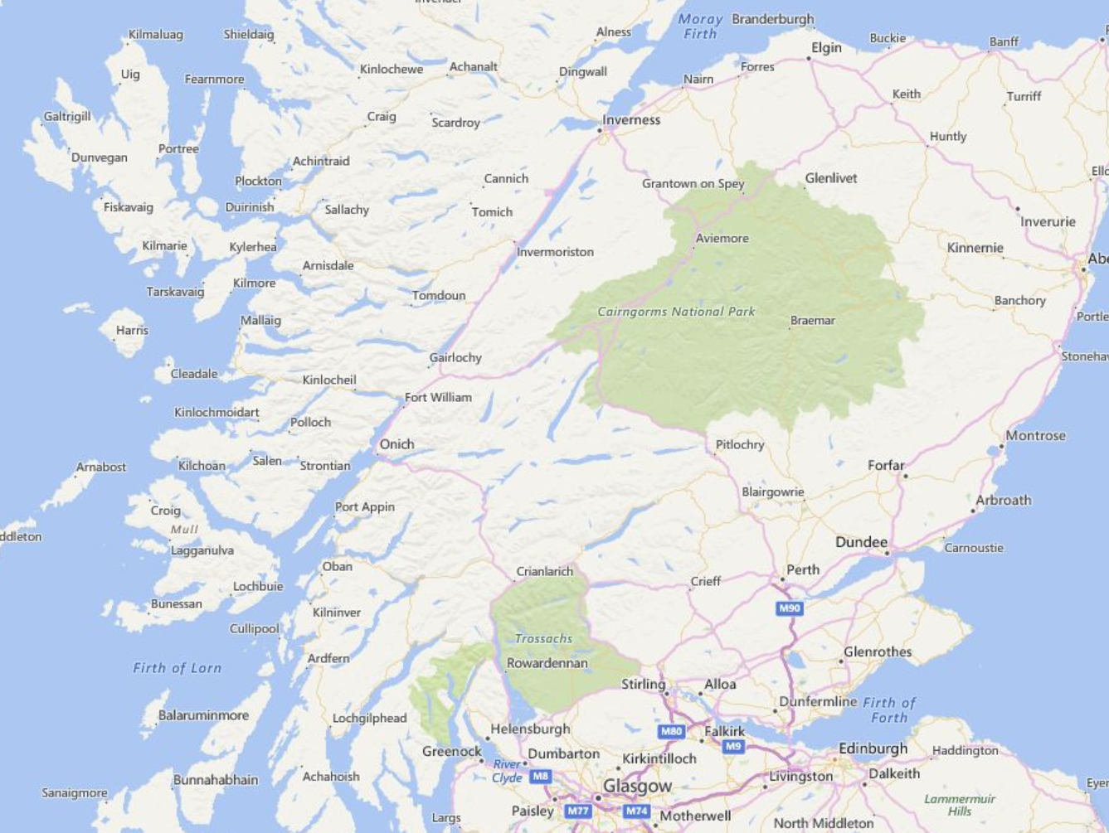

Slide 5
Aviemore, Glenmore & Strathspey
Royal Deeside
Notes:
Tomintoul and Glenlivet is located between the tourist hotspots of Aviemore, Glenmore and Strathspey to the west and Royal Deeside to the east
Tomintoul and Glenlivet has to work very hard to take advantage of this location, with day trips and short stays being the main market

Slide 6
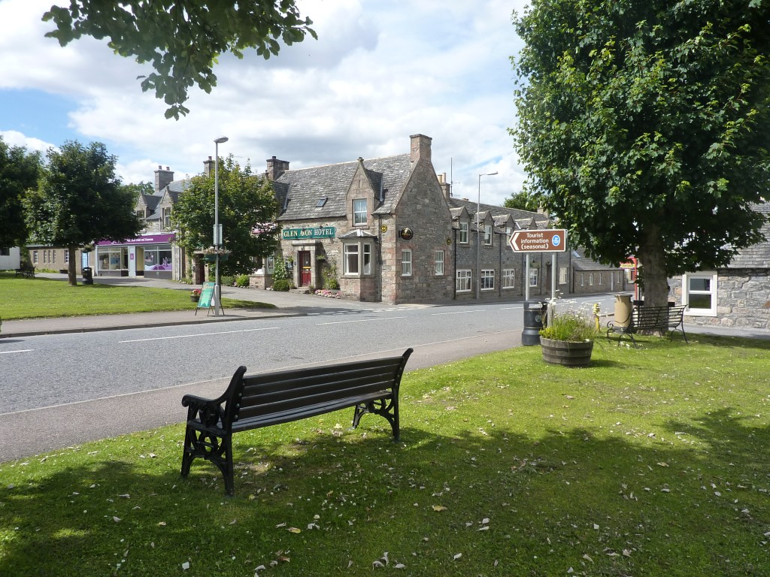
1. Background
Historic challenges
Purpose and role
Topography
Population
Location
Global Financial Crash
Need to act – 2011 Hotels and VIC
Notes:
Global Financial Crash
Tomintoul and Glenlivet was of course not immune to the financial crash in 2007-08 and its consequences
By 2011 the VIC was under threat of closure and the two hotels in Tomintoul had closed and there were real concerns locally that the vital tourist trade would disappear
CNPA was able to support a refurbishment of the VIC – at the official reopening there were strong calls for much more investment and focus on the area to support the struggling economy.
Lead to establishment of working group to bring forward proposals. Funding put together for detailed socio-economic study and then development of Regeneration Strategy and Action Plan

Slide 7
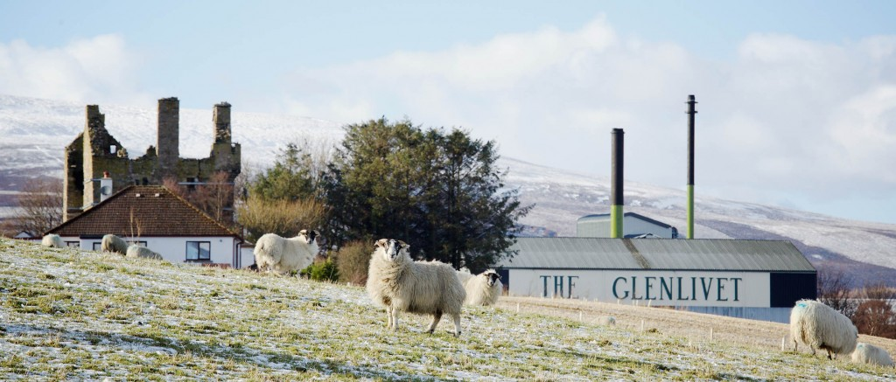
2. Regeneration Strategy and Action Plan
Steering Group
Baseline Assessments
Community Engagement
Surveys
Meetings
Focus Groups
National Park Partnership Plan
Development of Strategy & Action Plan
Transform Team
Notes:
A Steering Group was established, involving the two local community associations, Moray Council, CNPA, the Crown Estate and HIE
Funding was sourced and consultants brought in to undertake some initial socio-economic baseline assessments to give a true picture of the situation
Significant community engagement took place, led by partners and VABS to identify key issues and ideas
National Park Partnership Plan is the key management strategy for the National Park, covering all four aims (including socio-economic development)
2012-17 NPPP identified Tomintoul & Glenlivet as a spatial priority, recognising the significant challenges facing the area
Ongoing community engagement led to development of a Regeneration Strategy and Action Plan under a number of themes:
Funding & Delivery
Community Projects
Landscape Setting
Public Realm Improvements
Housing
Planning & Development
Sustainable Land Management
The “Transform Team” was established to oversee the delivery of the identified projects, providing a scrutiny and advisory role
Chaired by CNPA Board Member and member of GICA
KATCA
TGDT
TGHH
Crown Estate
Moray Council
HIE
Visit Scotland

Slide 8
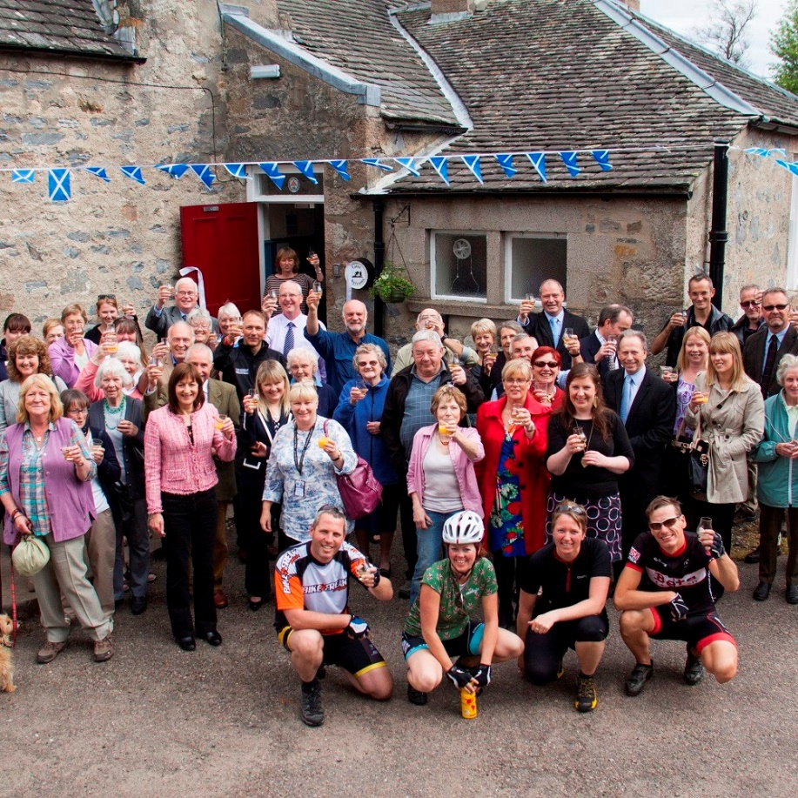
3. Development Trust
Established 2012
Legal status and structure
Finances & Staffing
Account Management – CNPA input
Successes
Future priorities
Notes:
Key priority in Regeneration Strategy was the establishment of a Development Trust
Company Ltd by Guarantee, membership open to all residents of AB37 9 postcode area and directors elected from the membership
Funded through joint funding from HIE, Moray Council, CNPA and Crown Estate (in-kind)
Development Officer position has been funded since 2012
Various other positions funded on shorter-term basis, including graduate placements – one of these is now running the Speyside Whisky Festival
HIE have account managed TGDT since 2012, offering direct support to officers and board members. CNPA has had input into this as and when required, but HIE take the lead. CNPA provide funding to HIE as a contribution for TGDT costs, all administered by HIE
TGDT has had a number of successes covering:
Management and now ownership following CAT of Smugglers Hostel (and campsite)
Management and now ownership following CAT of VIC and Museum (and securing funding for £500k refurb inc. office space)
Various events such as Rock n Road, (Skerryvore Gig, quiz nights)
(Pilot) broadband scheme to Braes of Glenlivet
TGDT producing plan setting short, medium and long term priorities and TGDT’s role over that period – focussing on non-TGLP matters

Slide 9
4. Landscape Partnership
What is it?
Stage 1
Stage 2 Development
Delivery Phase
Partnership & Accountability
TGDT role
Notes:
Landscape Partnerships are partly HLF funded projects designed to bring improvements to an area at a landscape scale, covering socio-economic, environmental and cultural issues and priorities
A number of the priorities identified in the initial Regeneration Strategy were brought into the TGLP proposals as an appropriate funding mechanism
Stage 1 was led by CNPA and external consultants, with input from key partners including RCAHMS, RSPB and a number of Transform Team members (including TGDT), with the application submitted in May 2014. This included general principles and outline costs, but was not particularly detailed
Stage 1 application approved in late 2014 and the Development Phase, including the production of a Stage 2 application commenced in early 2015. This involved bringing forward more detailed and costed proposals which would be delivered following approval of the Stage 2 application, which was submitted in May 2016
Stage 2 application was approved in September 2016 and the Delivery Phase started.
TGLP has its own Board and staffing arrangements – the Board is made up of representatives from the key partners who provide oversight and scrutiny of project delivery (including TGDT)
TGDT is leading on three key projects and is employing two new members of staff to support delivery

Slide 10
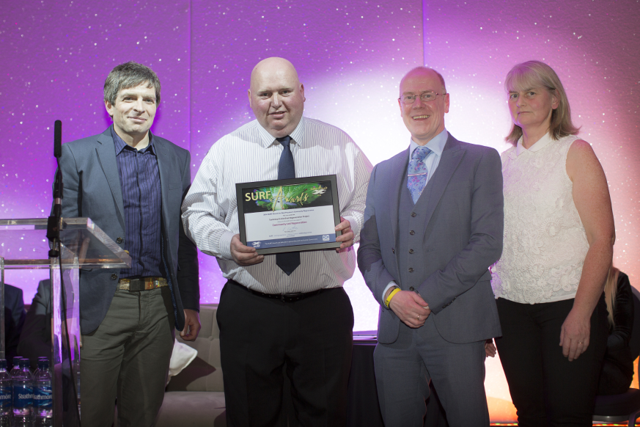
5. The Future
Regeneration Strategy
TGDT Strategy
National Park Partnership Plan
Crown Estate
Notes:
The Regeneration Strategy is 5 years old and needs review – needs to be led locally
TGDT are finalising their strategy of the next five years – potential for this to be a key part of a wider Action Plan for T&G to replace the Regeneration Strategy
NPPP for 2017-2022 is proposing an additional spatial priority area in Badenoch which will result in the focus on T&G from a CNPA perspective having to change
The Crown Estate owns the vast majority of the land in Tomintoul & Glenlivet and its devolution to Scottish Government and future management structures will have a significant bearing on the community

Slide 11
6. Ongoing Challenges & Lessons
Financial independence
Community support and engagement
Community capacity building
Volunteering
Notes:
TGDT is a thriving social enterprise providing jobs and other opportunities in a fragile area and are now generating an element of income through the Smugglers Hostel and their events portfolio
Still reliant on public funding for core costs and this is unlikely to change in the short to medium term, but difficult to justify maintaining current levels of funding beyond 2018
Ambitions to increase revenue raising opportunities through additional asset management
Community support and engagement has been an ongoing priority and has not been straightforward. Clear and consistent communication and engagement with local residents, members and partners is essential.
Managing community expectations has also been a key consideration
T&G is certainly a more confident and active community in terms of community development, however this relies on a small cohort of very busy volunteers. TGDT directors are taking on more and more, allowing staff to focus on project delivery, however there is a need to continue to attract support and involvement from local people. A long term commitment to build volunteer capacity and allow for succession planning is key and TGDT have made significant strides in this area, with a stronger and more settled Board over the last 2 years

