Slide 1


Family Approach
Whole Family Support
Notes:
Angela

Slide 2
Lone Parent
Child Under 1
Family Approach
Disabled Adult or Child
The Six Child Poverty Priority Groups
Parent Under 25
Ethnic Minority
3 or more Children
Notes:
Ruairidh

Slide 3
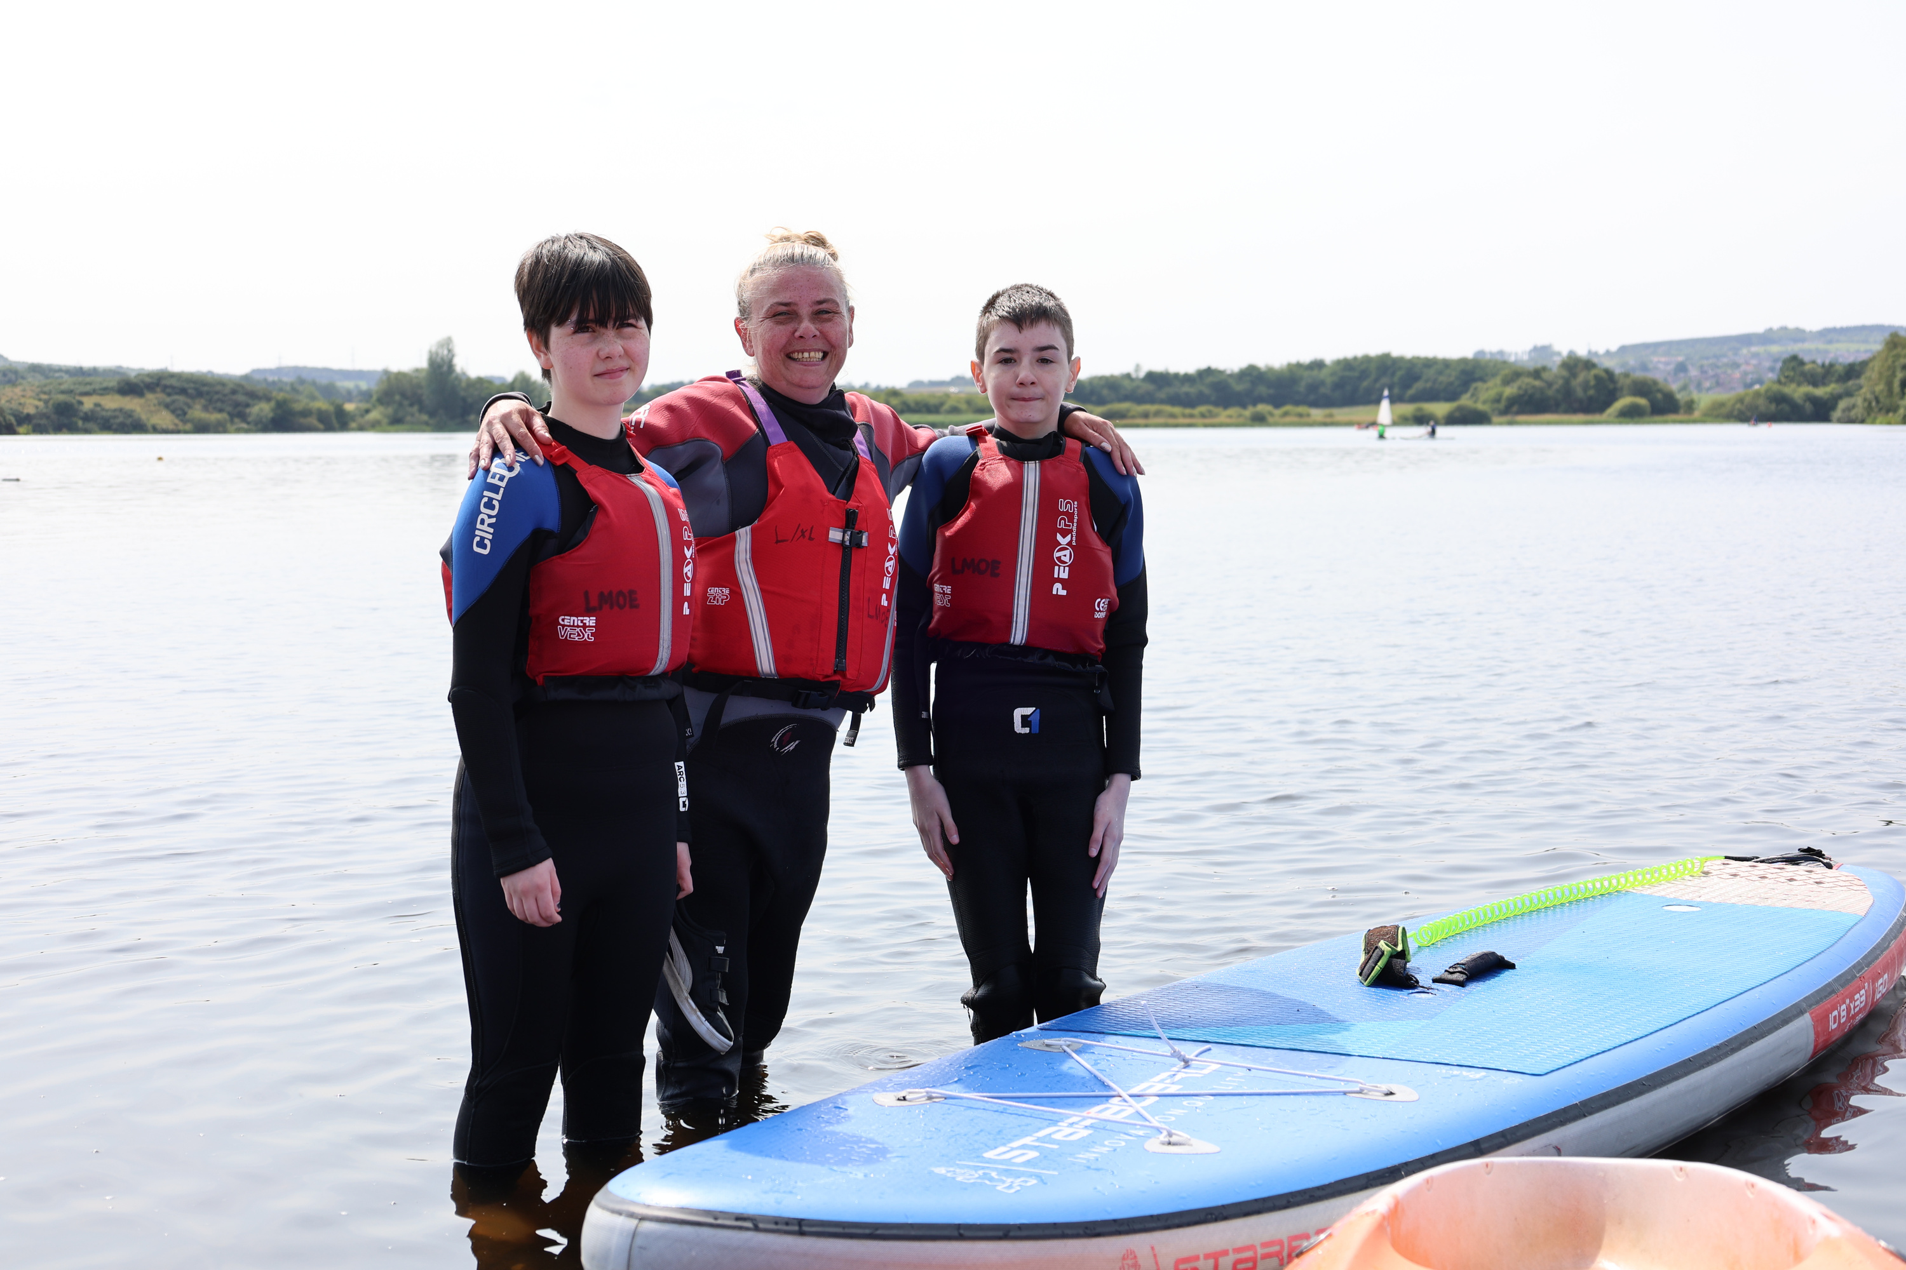
“Better todays
and brighter tomorrows”
Notes:
Ruairidh

Slide 4

We aim to improve the life chances of both parents and children by supporting families to progress towards employment, education or volunteering.
With strong foundations in place, employment is more sustainable
Notes:
Ruairidh

Slide 5



Notes:
Ruairidh

Slide 6

Volunteering & Training Opportunities
With you
every step of the way!
Family Learning & Education Advocacy
Employability
& In-work Support
Understanding Housing
Managing Universal Credit
Well-being & Peer Support Groups
Money, Benefits & Debt Advice
Health Advocacy
Notes:
Ruairidh

Slide 7
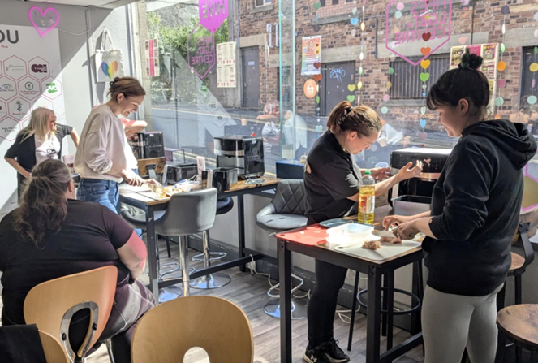
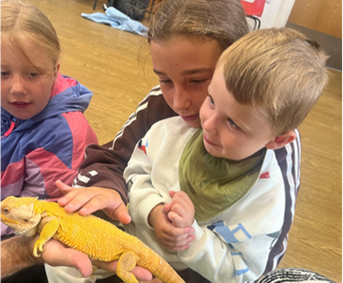
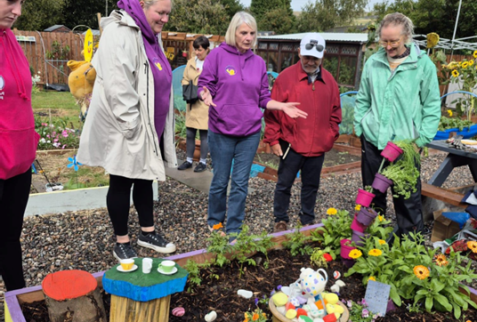
Notes:
Angea

Slide 8

Notes:
Angela

Slide 9
Success and Impact
The project has demonstrated strong outcomes for parents and families, particularly those facing complex challenges.

Slide 10
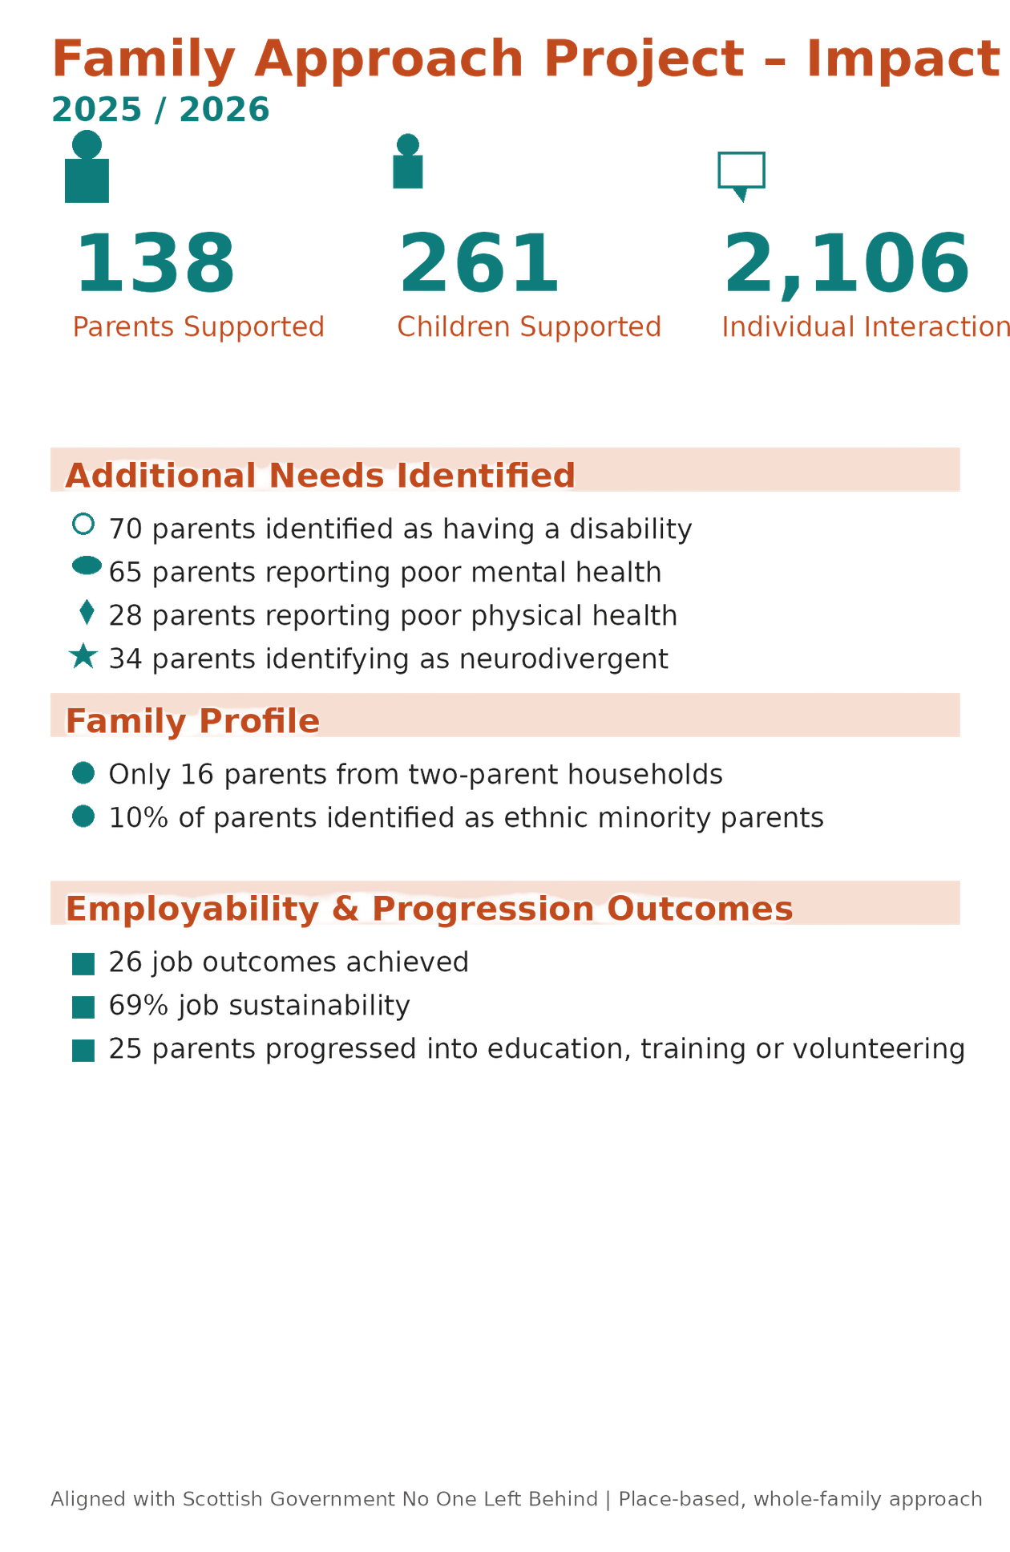
Notes:
Angela

Slide 11
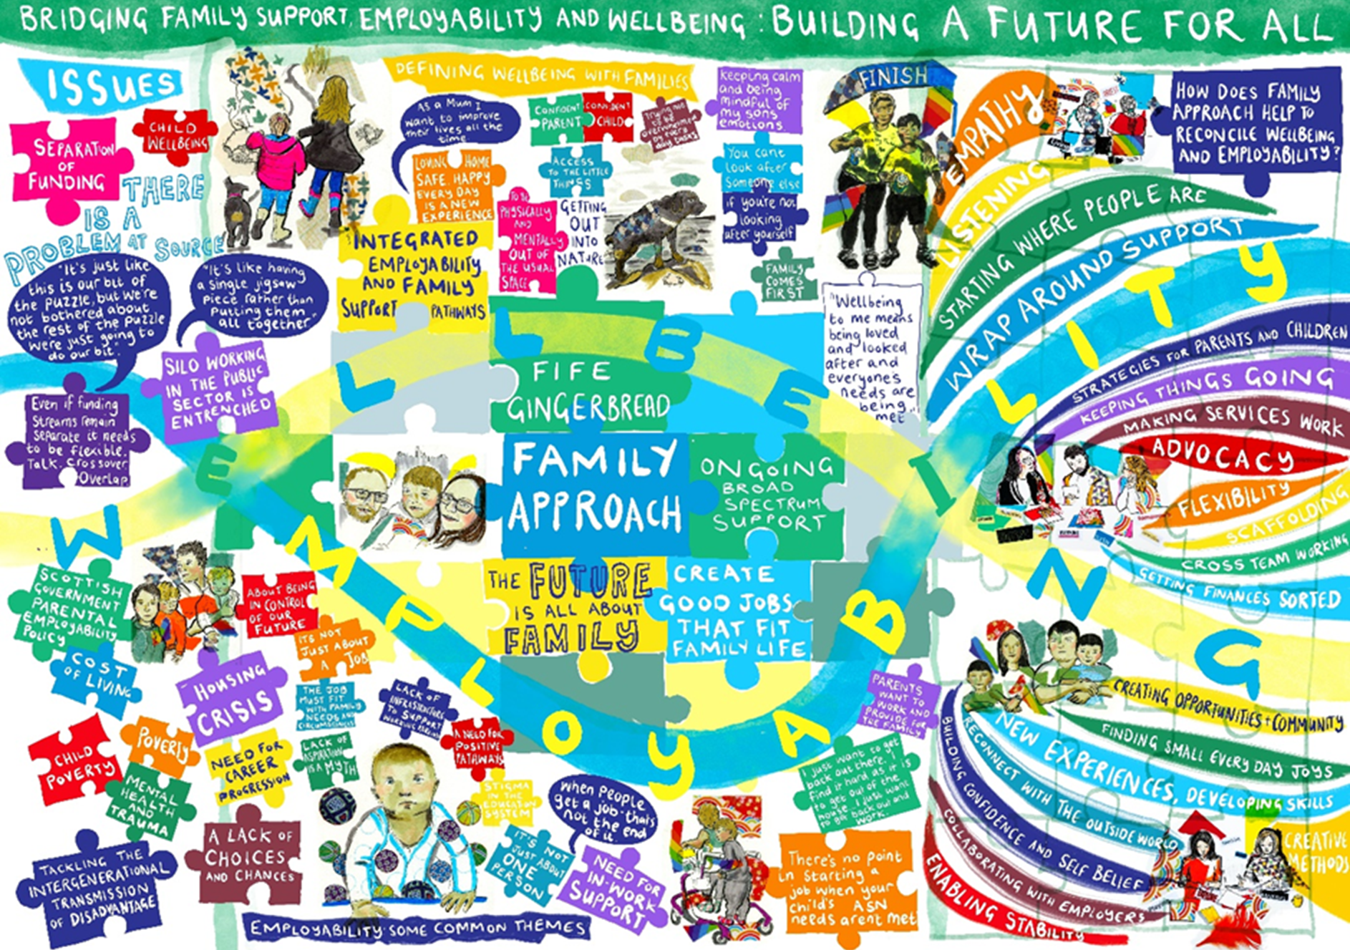
Lone parent in Fife
Care‑experienced childhood
Left home at 14
Strong work ethic, limited family support
Case Study
Notes:
Ruairidh

Slide 12
Challenges Identified
Despite positive outcomes, the project has faced ongoing challenges
Notes:
Angela

Slide 13
The Family Approach project demonstrates that investing in parents is not just a social intervention, but a regeneration strategy : strengthening families, increasing economic participation and supporting more resilient, inclusive communities
Notes:
Angela

Slide 14

Any questions?
Get in touch:
angela@fifegingerbread.org.uk
ruairidh.gough@fifegingerbread.org.uk
wwwfifegingerbread.org.uk

